Slide 1
Nepravidelná slovesa 6. ročník 2. část
Mgr. Alena mikulecká

Slide 2
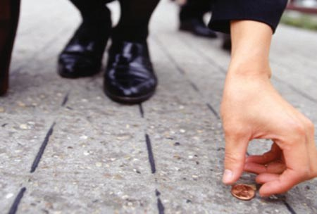
najít
find
found
found
I found some money.
I didn´t find any money.
Did you find any money?

Slide 3
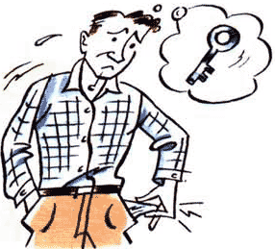
ztratit
lose
lost
lost
He lost the keys
He didn´t lose the keys.
Did he lose the keys?

Slide 4
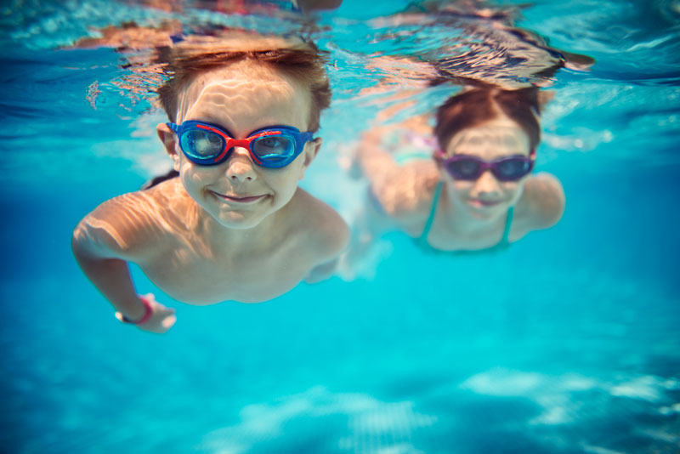
plavat
swim
swam
swum
They swam in the pool.
They didn´t swim in the pool.
Did they swim in the pool?

Slide 5
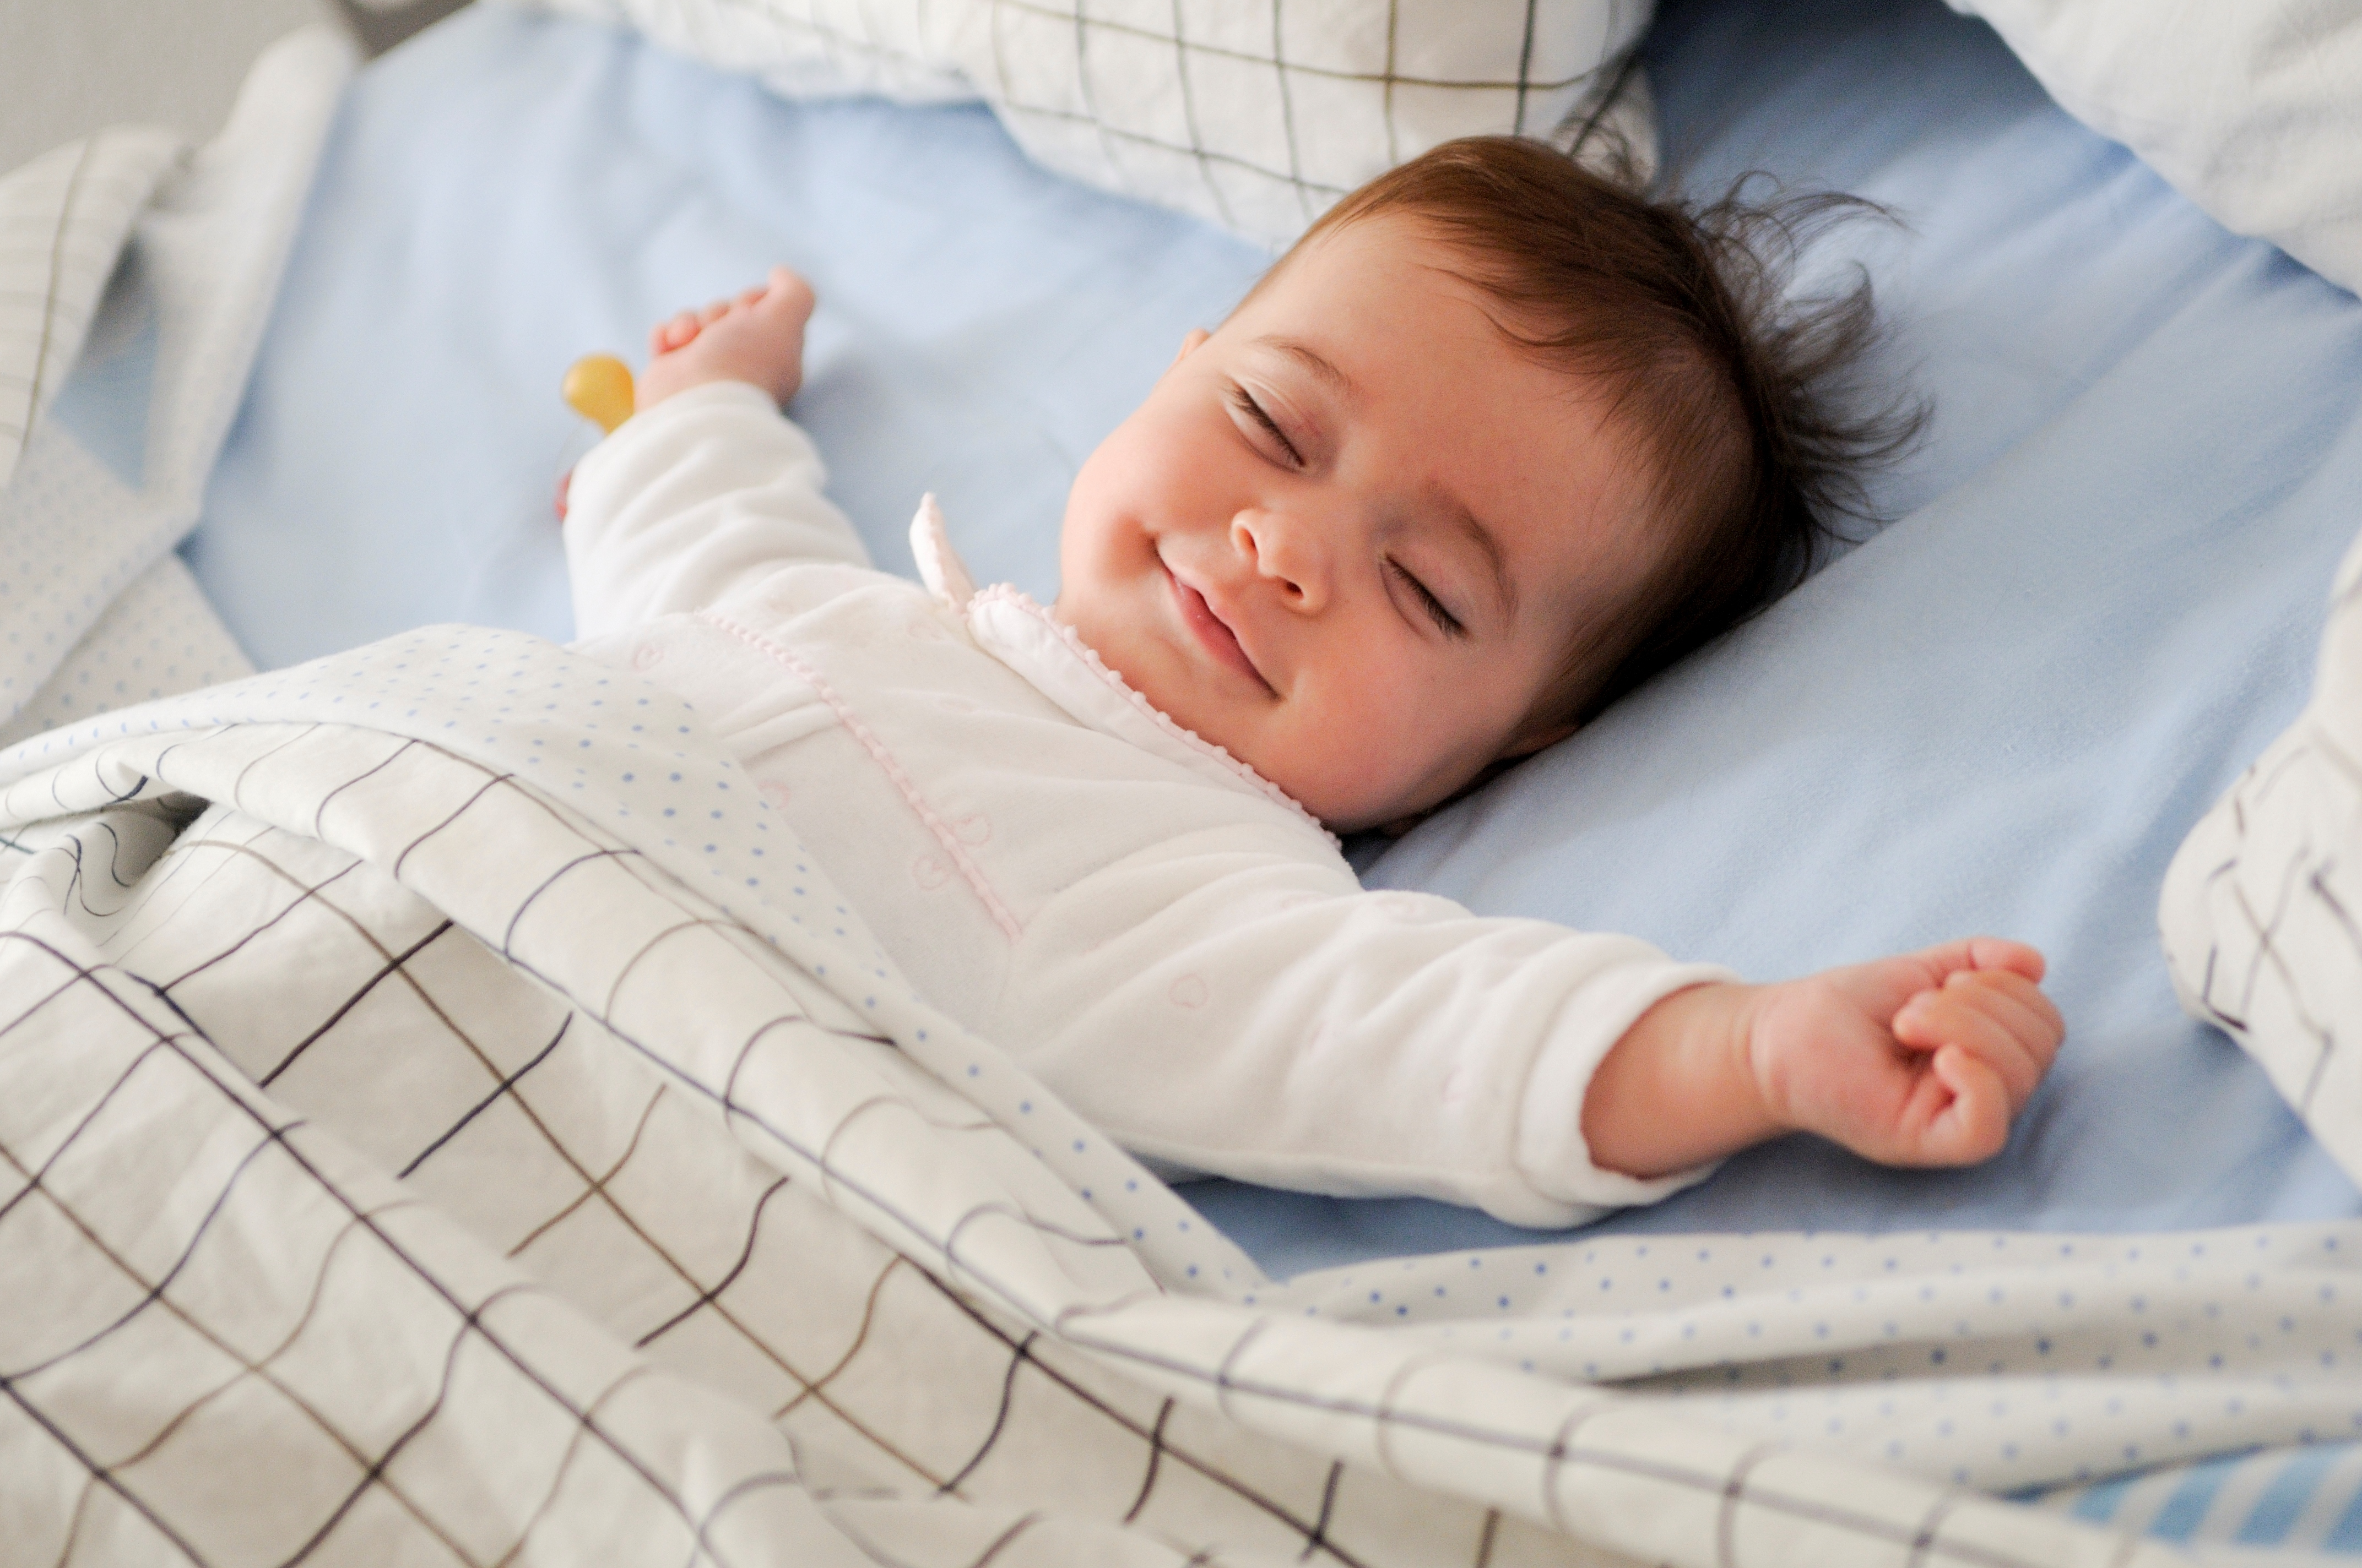
spát
sleep
slept
slept
He slept.
He didn´t sleep.
Did he sleep?

Slide 6
vzít, brát
take
took
taken
We took the bus.
We didn´t take the bus.
Did we take the bus?

Slide 7
psát, napsat
write
wrote
written
I wrote my homework.
I didn´t write my homework.
Did you write your homework?

Slide 8
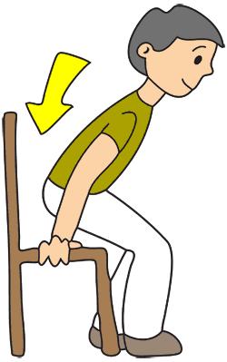
sedět
sit
sat
sat
I sat on the chair.
I didn´t sit on the chair.
Did you sit on the chair?

Slide 9
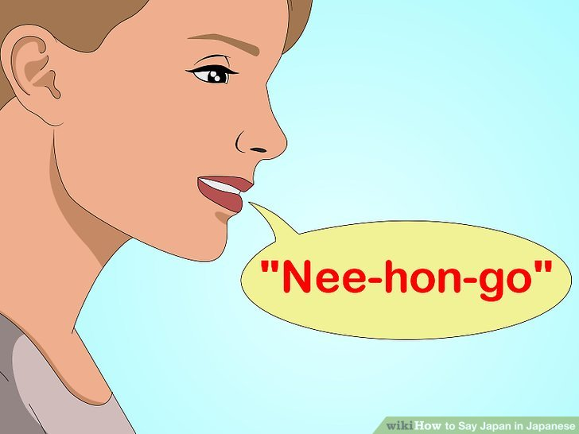
říkat
say
said
said
I said that to him.
I didn´t say that to him.
Did you say that to him?

Slide 10
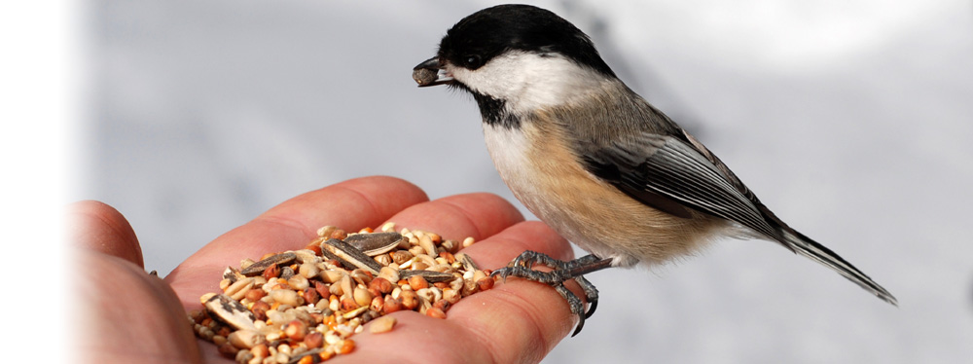
krmit
feed
fed
fed
I fed the bird.
I didn´t feed the bird.
Did you feed the bird?

Slide 11
koupit
buy
bought
bought
I bought a new jacket.
I didn´t buy a new jacket.
Did you buy a new jacket?

Slide 12
mluvit
speak
spoke
spoken
I spoke English.
I didn´t speak English.
Did you speak English?

Slide 13
Say the three forms:
najít
ztratit
plavat
spát
vzít
psát
sedět
říct
krmit
mluvit
koupit

Slide 14
Say past forms:
find
lose
swim
sleep
take
write
sit
say
feed
speak
buy

Slide 15
Answer these questions:
Did you swim yesterday?
Did you sleep yesterday in the afternoon?
Did you take the bus yesterday?
Did you write your homework yesterday?
Did you feed some animal yesterday?
Did you speak English yesterday?
Did you buy something yesterday?
Did you say „Hello“ yesterday?
Did you lose your money?
Did you find some money?

Slide 16
Complete:
I _______________(find) the keys.
You__________________(lose) your mind.
We____________________(swim) in the pool.
They ____________________(sleep) in the car.
I__________________(take) the bus.
Children___________________(write) their homework.
My friend__________________(sit) next to me.
We___________________(feed) the cat in the street.
We________________________(speak) English.

