Slide 1

L O O K
SANDRIM

Slide 2
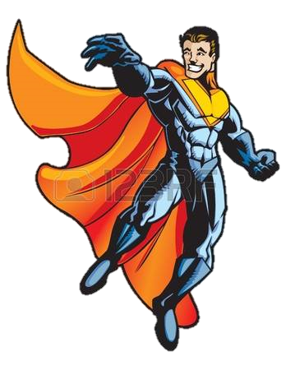
L
look + adjective
He looks brave.
O
look like + noun
O
He looks like a spiderman.
look as if + sentence
K
He looks as if he is saving mankind

Slide 3

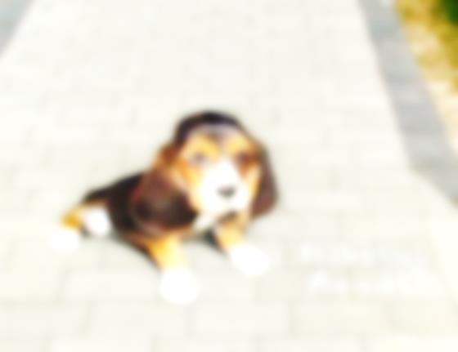
L
What does he think looking at 3D pictures?
Make up sentences using
look
look like
look as if
O
O
K

Slide 4
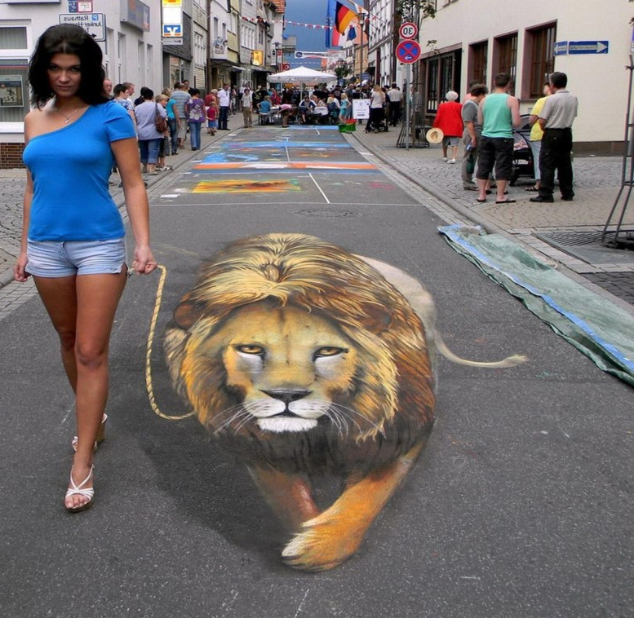
The girl looks as if she is walking the lion.
The girl
look as if

Slide 5
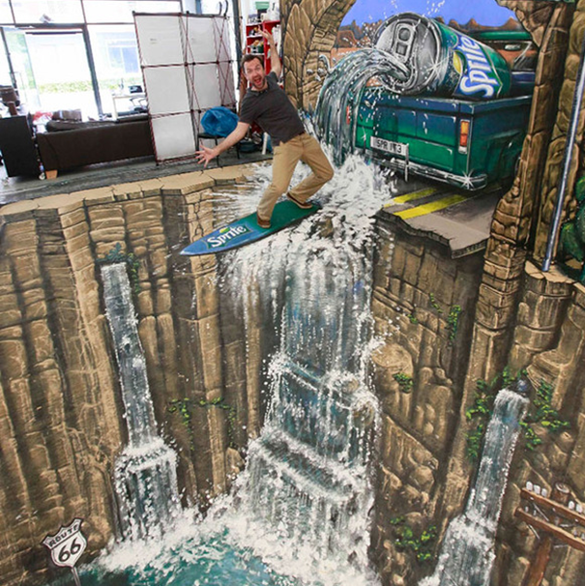
The man looks scared.
look
The man

Slide 6
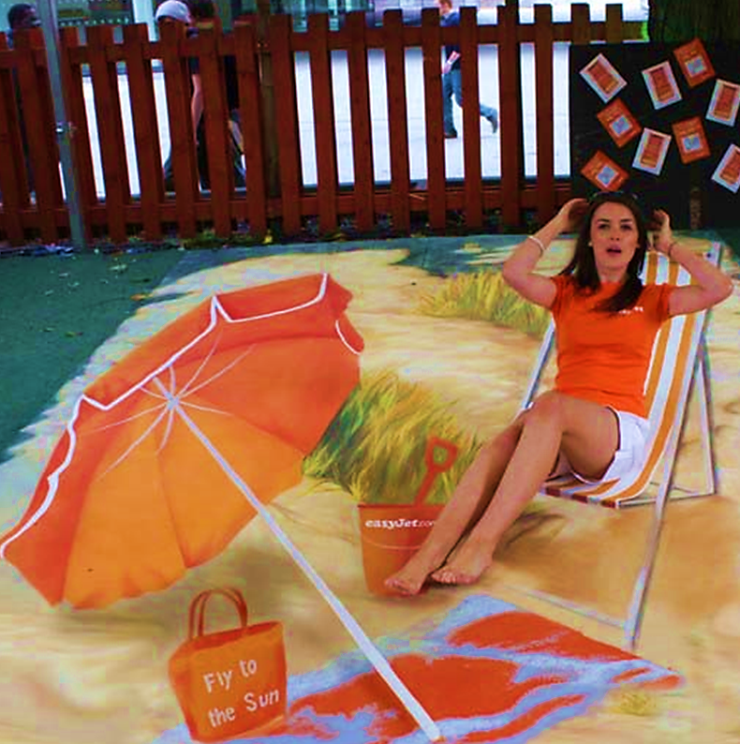
The girl looks as if she is on the beach.
look
as if
The girl

Slide 7
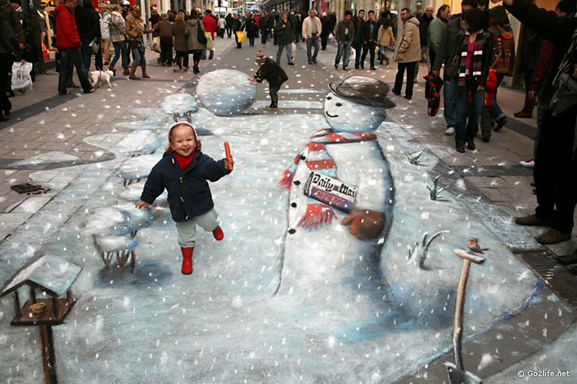
It looks like winter.
It
look like

Slide 8
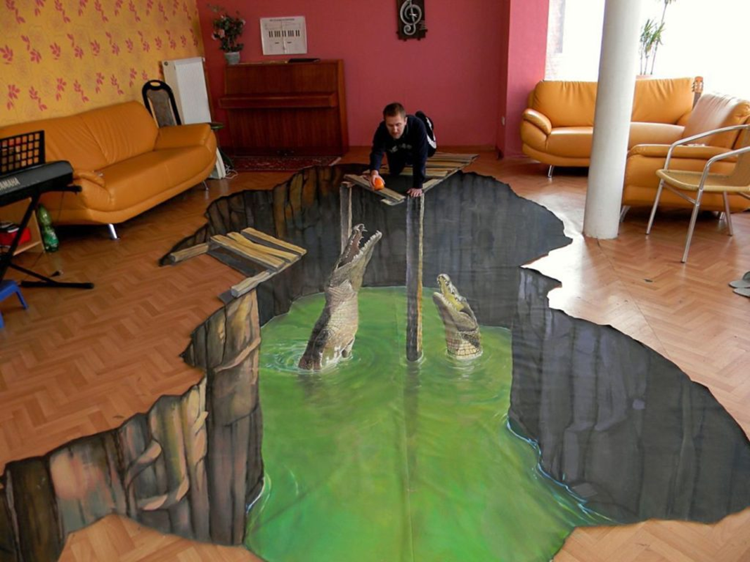
The man looks as if he is feeding the crocodiles.
look as if
The man

Slide 9
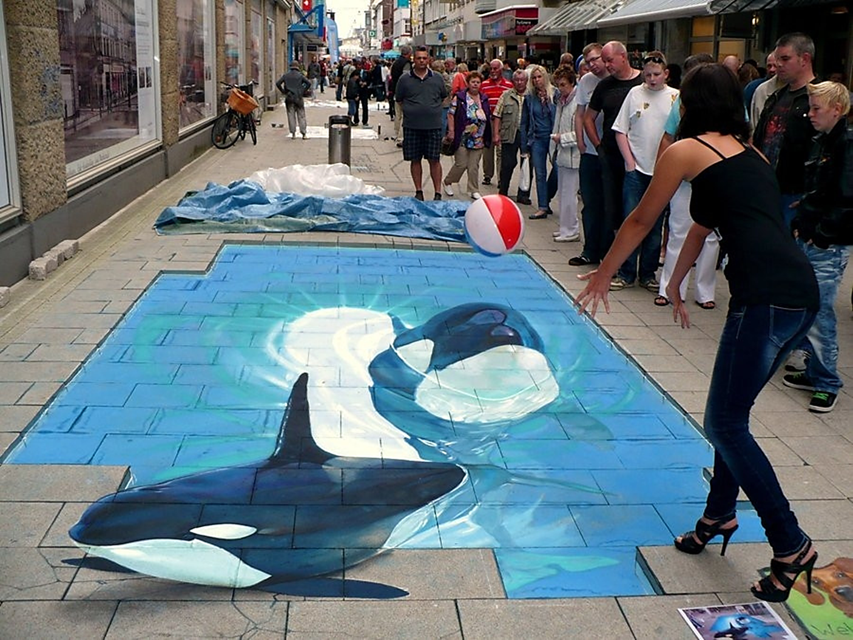
The girl looks like a dolphin trainer.
look like
The girl

Slide 10
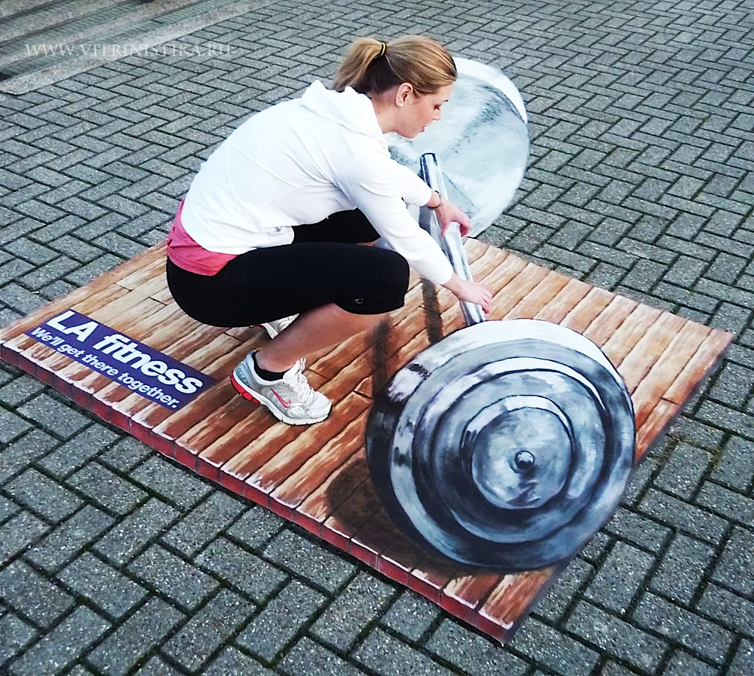
She looks strong.
She
look

Slide 11
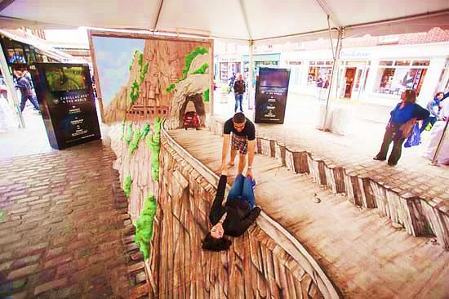
The man looks as if he is saving his girlfriend.
look as if
The man

Slide 12
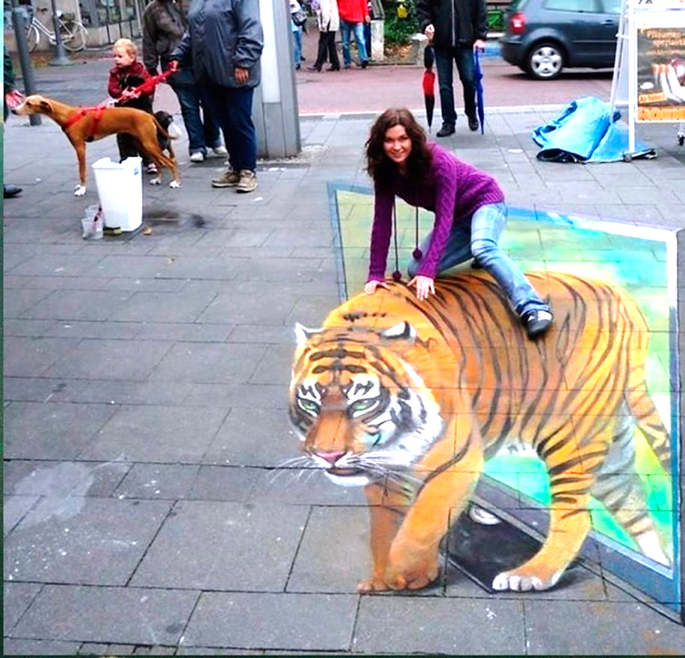
The girl looks as if she is riding a tiger.
look as if
The girl

Slide 13

THE END

