Slide 1
Minulý čas pravidelných sloves – kladné věty
Mgr. Alena mikulecká

Slide 2
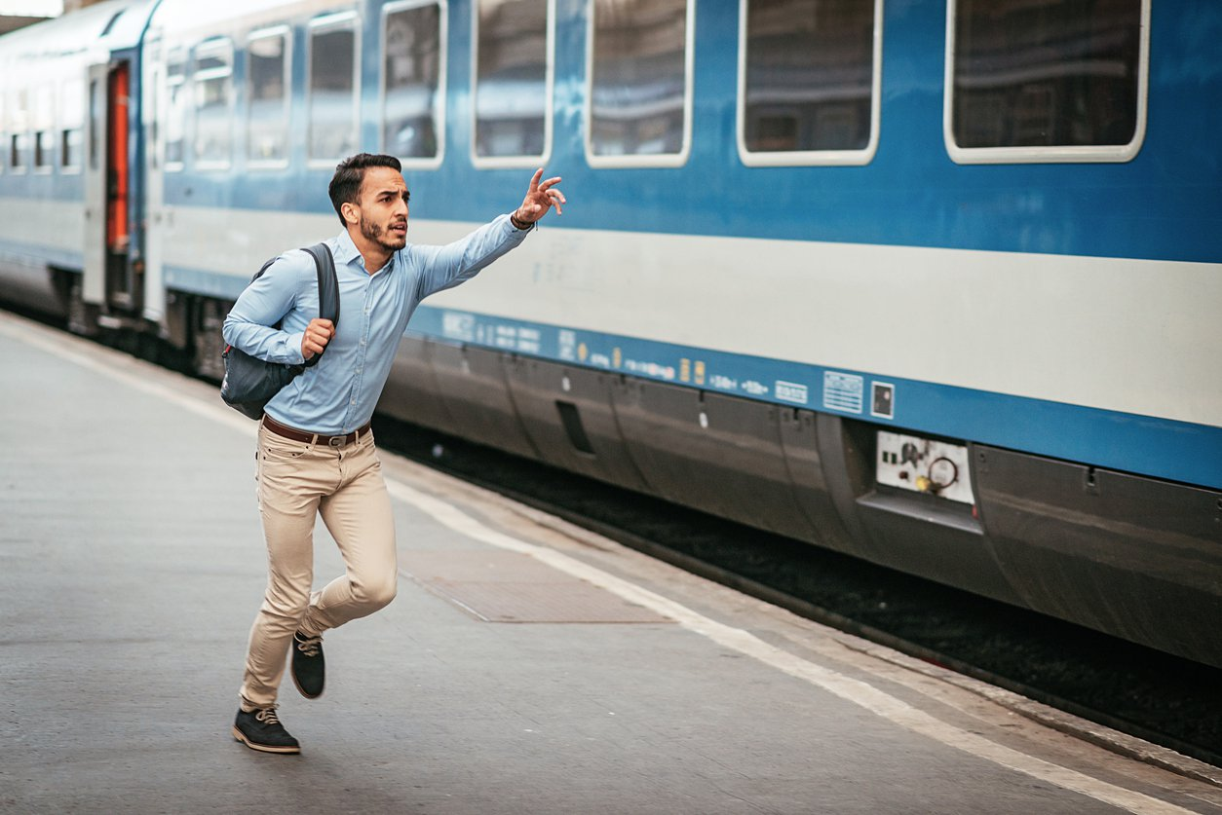
sloveso+ ED
He / Miss a train
He missed a train

Slide 3
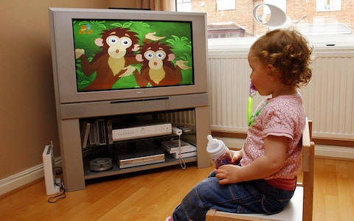
she /watch TV yesterday
She watched tv yesterday

Slide 4
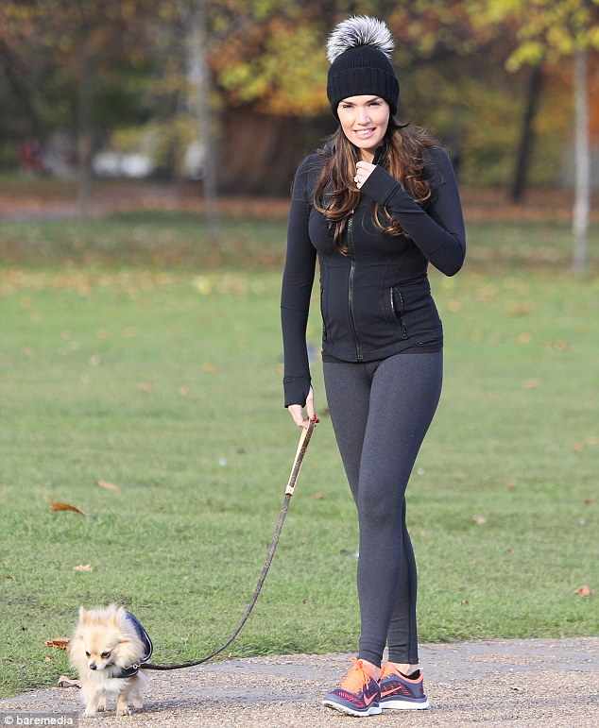
She / walk last week
She walked last week.

Slide 5
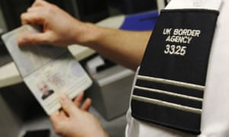
He /check/ his passport
He checked his passport

Slide 6
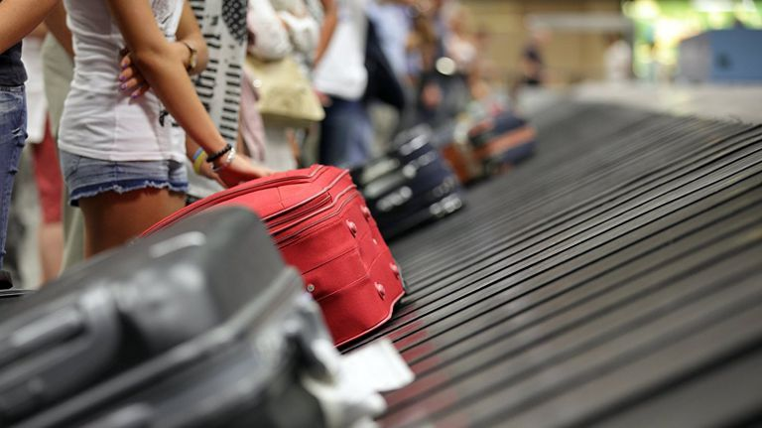
We / pick up /our suitcase
We picked up our suitcase.

Slide 7
She/arrive/ in the airoport
She arrived in the airport

Slide 8
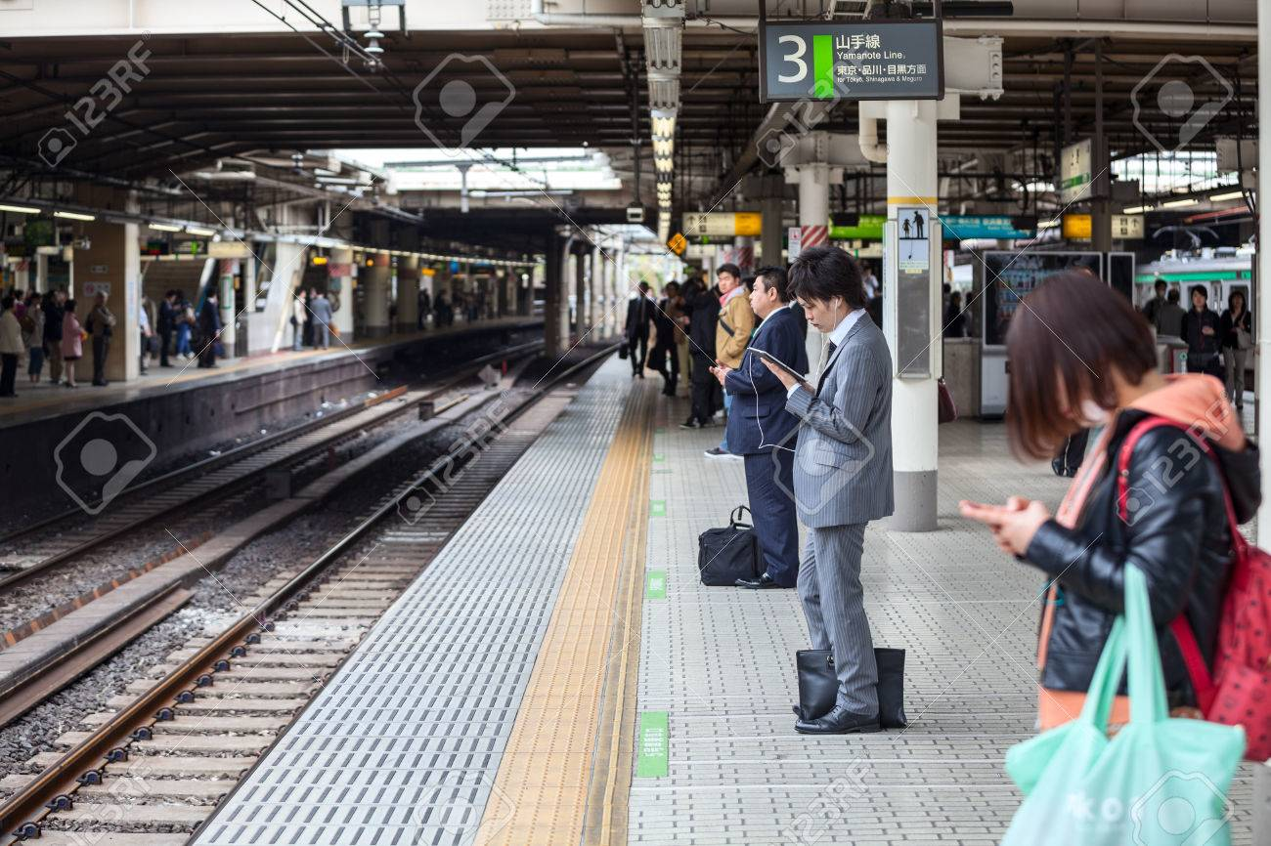
They / wait / for the train
They waited for the train.

Slide 9
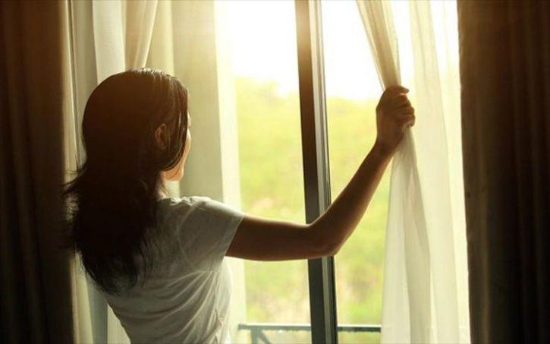
She / open the window
She openned the window.

Slide 10
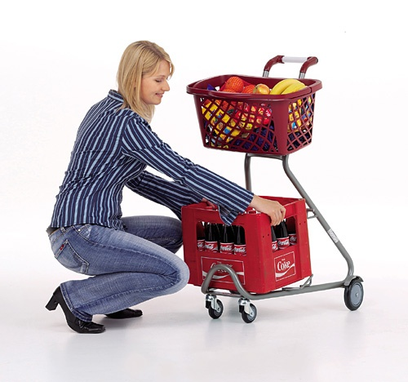
She/grab the trolley
She grabbed the troley.

Slide 11
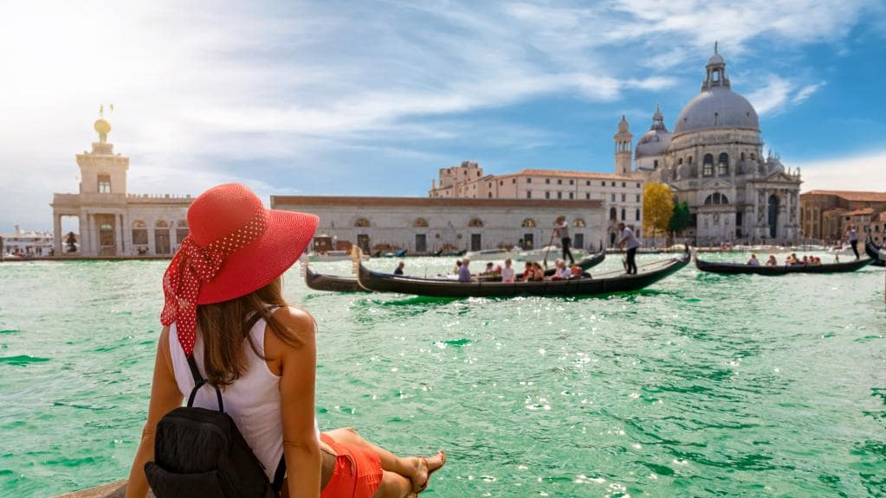
She / travel to italy
She travelled to Italy.

Slide 12
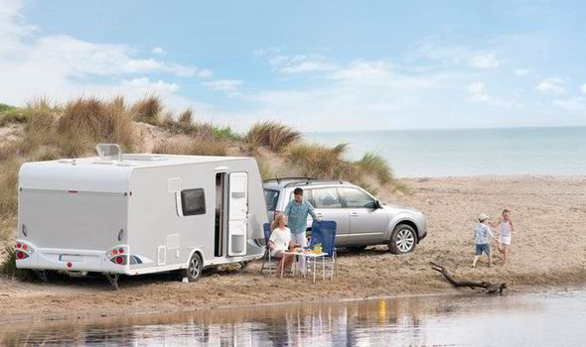
they / try the caravan
They tried the caravan.

Slide 13
They / study at school
They studied at school.

Slide 14
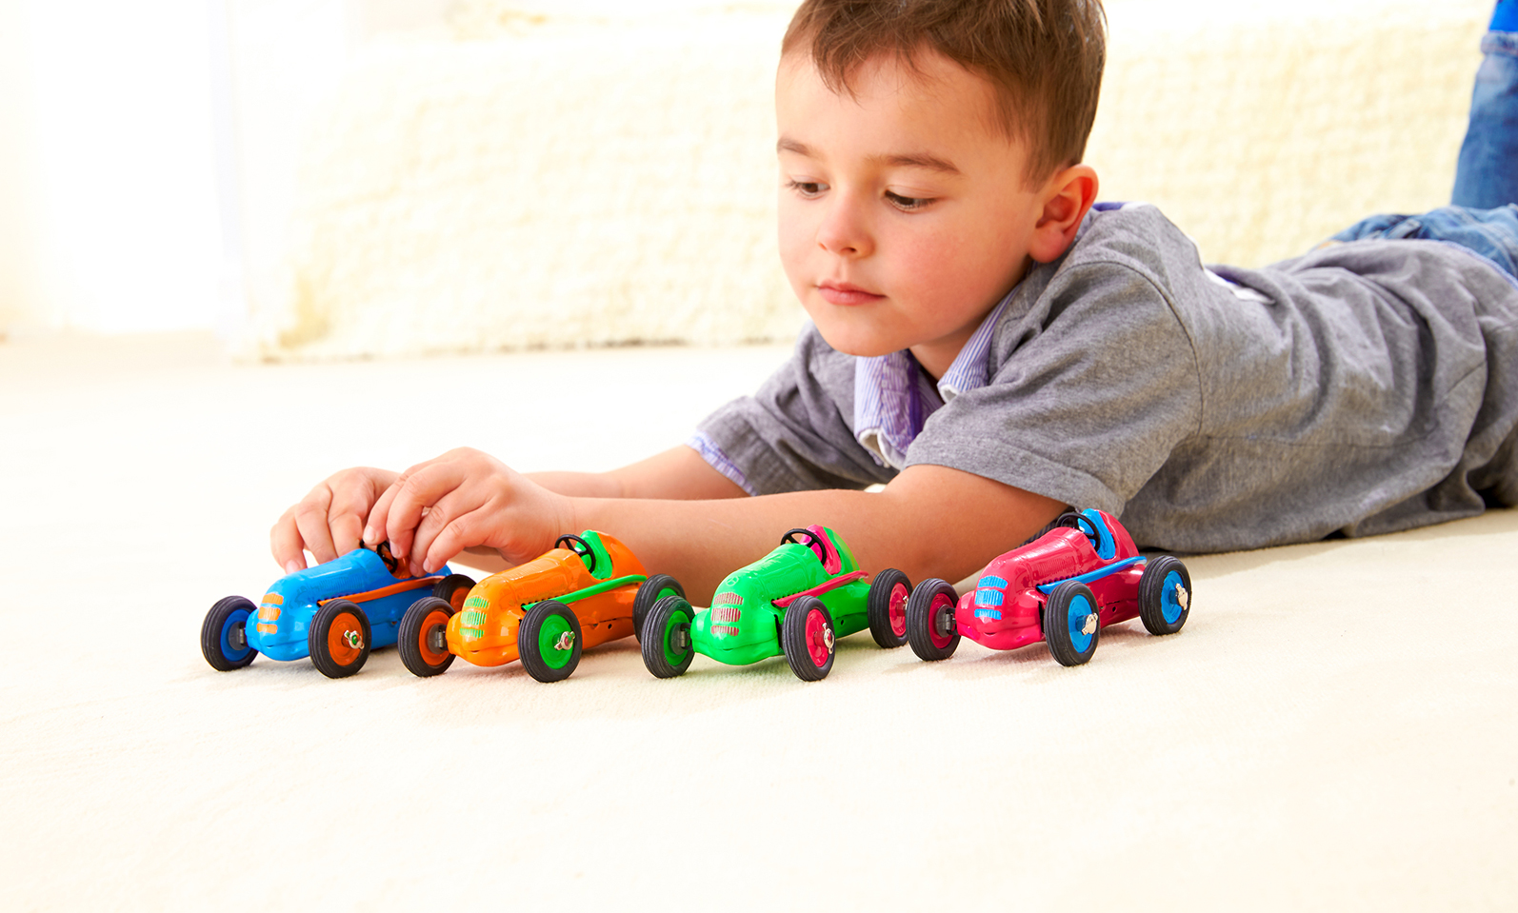
He / play with toys
He played with toys.

Slide 15
Game: how good is your memorry? A: I waited for a train B: you waited for a train and I studied at school c: you waited for a train, you studied at school and I watched tv D: you waited for a train, you studied at school, you watched tv and i played with toys a: i waited for a train, you studied, you watched tv, you played with toys and i tried a caravan…
Miss a train try a caravan play with toys
Pick up a suitcase collect a ticket start a game
Arrive at the airport need a tent walk with the dog
Check a passport study at school stay in a hotel
Wait for a train open a window watch tv
Grab a trolley close a book visit museum
Shout at my cousin travel to Italy want a cd

Slide 16
song
https://www.youtube.com/watch?v=0b4rsDuzThE&t=13s

