Slide 1
Minulý čas pravidelných sloves – záporné věty a otázky
Mgr. Alena mikulecká

Slide 2
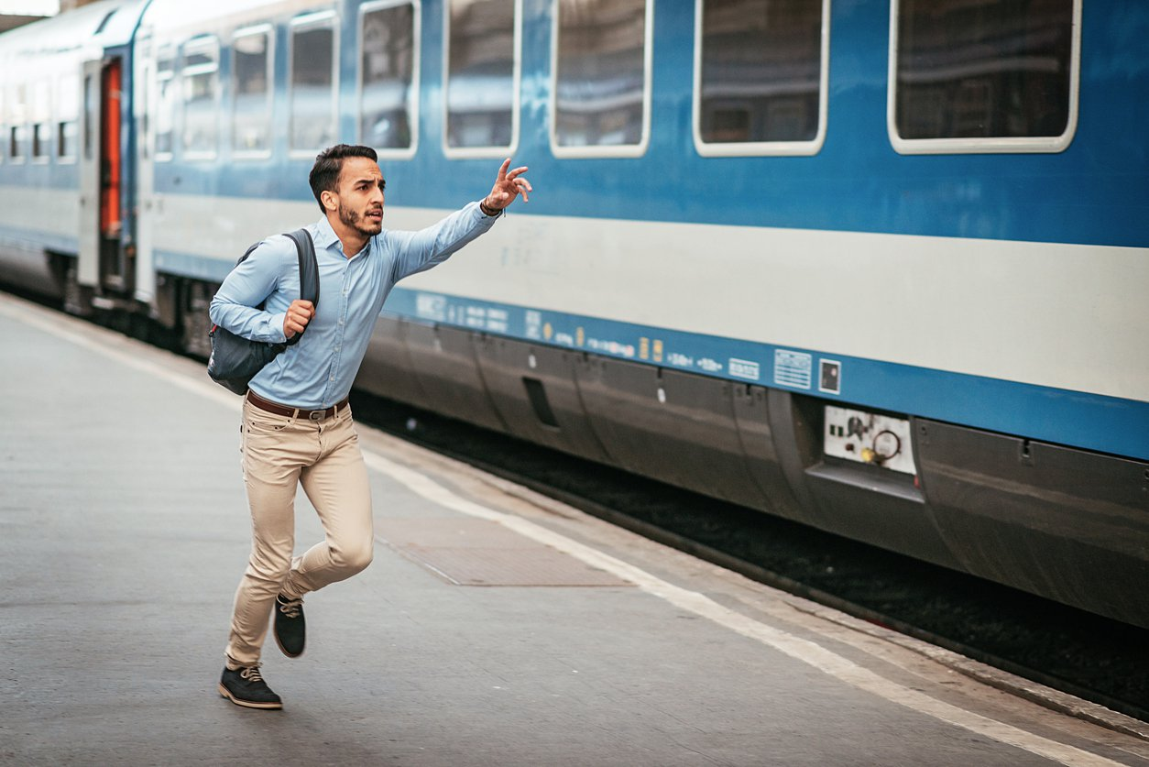
+ sloveso+ ED - didn´t + sloveso ? Did + sloveso
He / not Miss a train
He didn´t miss a train
?
Did he miss a train?

Slide 3
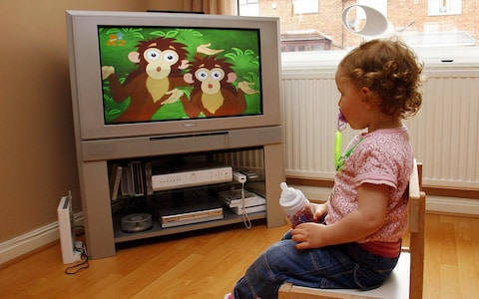
she / not watch TV yesterday ?
She didn´t watch tv yesterday
Did she watch tv yesterday?

Slide 4
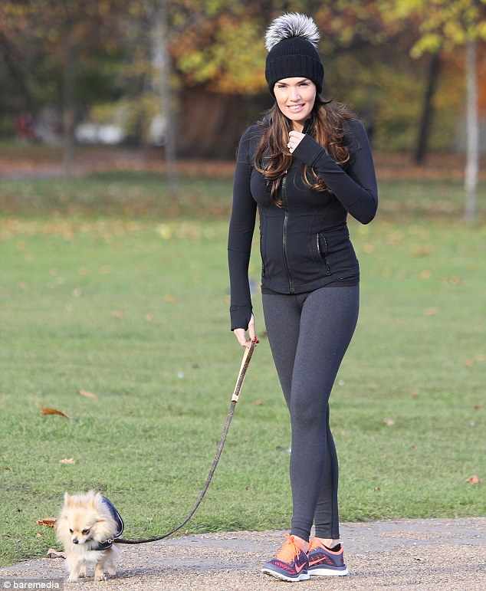
She / not walk last week ?
She didn´t walk last week.
Did she walk last week?

Slide 5
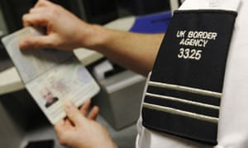
He /not check/ his passport ?
He didn´t check his passport.
Did he check his passport?

Slide 6
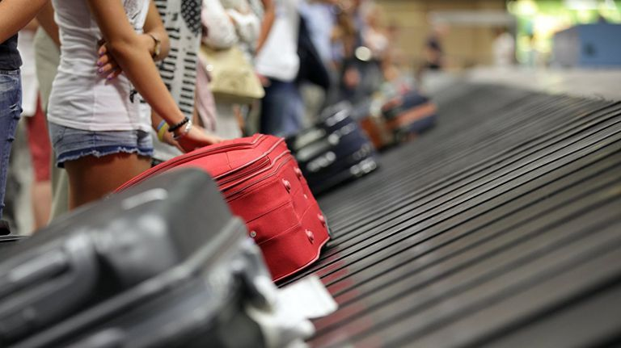
We / not pick up /our suitcase ?
We didn´t pick up our suitcase.
Did we pick up our suitcase?

Slide 7
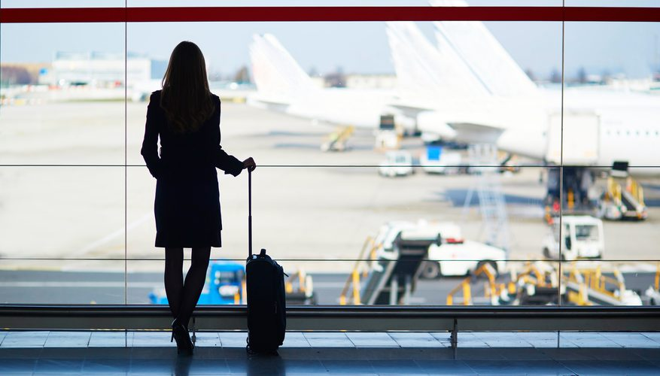
She/not arrive/ at the airoport ?
She didn´t arrive at the airport
Did she arrive at the airport?

Slide 8
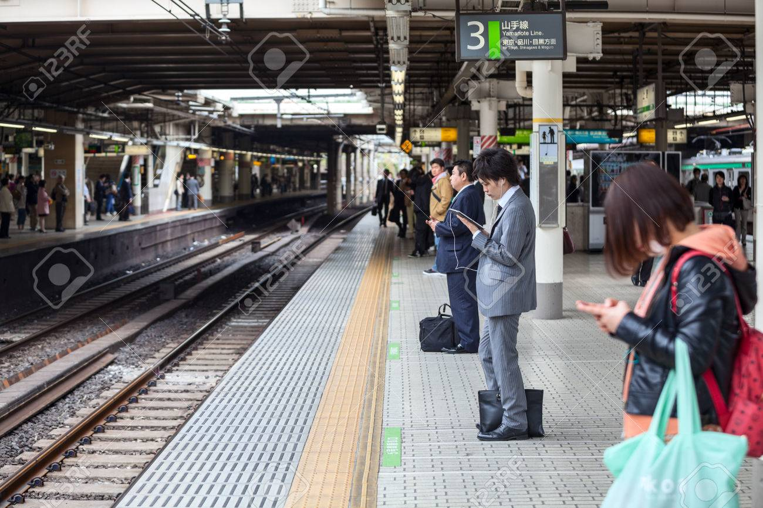
They / not wait / for the train ?
They didn´t wait for the train.
Did they wait for the train?

Slide 9
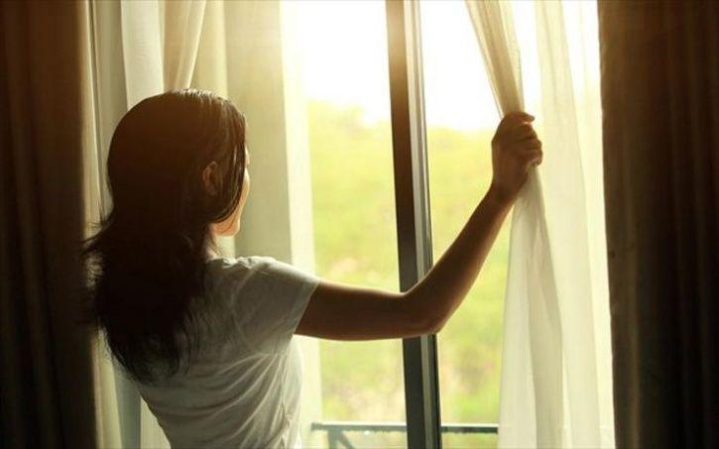
She / not open the window ?
She didn´t open the window.
Did she open the window?

Slide 10
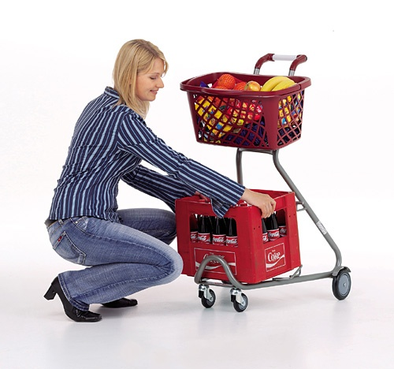
She/not grab the trolley ?
She didn´t grab the trolley.
Did she grab the trolley?

Slide 11
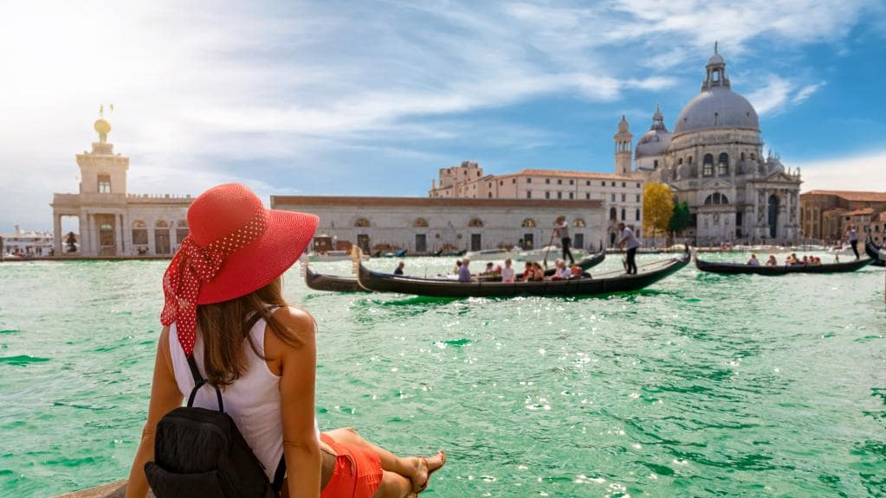
She / not travel to Italy ?
She didn´t travel to Italy.
Did she travel to Italy?

Slide 12
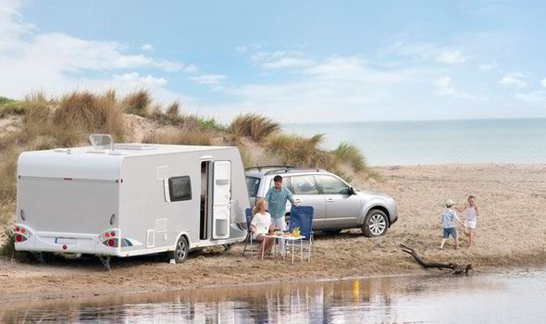
they / not try the caravan ?
They didn´t try the caravan.
Did he try the caravan?

Slide 13
They / not study at school ?
They didn´t study at school.
Did they study at school?

Slide 14
He / not play with toys ?
He didn´t play with toys.
Did he play with toys?

Slide 15
Game: find someone who…. A: did you travel to Italy last holidays? B: yes, I did. (a: writes his or her name) a: did you wait for the bus this morning? B: no, i didn´t. (a: has to find someone else)
1) Travelled to Italy last holidays
2) Missed a bus last week
3) Visited some museum this year
4) Watched tv yesterday
5) Played pc games yesterday
6) Studied english this week
7) Stayed in a hotel last holidays
8) Waited for your friend after school yesterday

Slide 16
song
https://www.youtube.com/watch?v=0b4rsDuzThE&t=13s

