Slide 1
Nepravidelná slovesa
6. ročník
1. část
Mgr. Alena Mikulecká

Slide 2
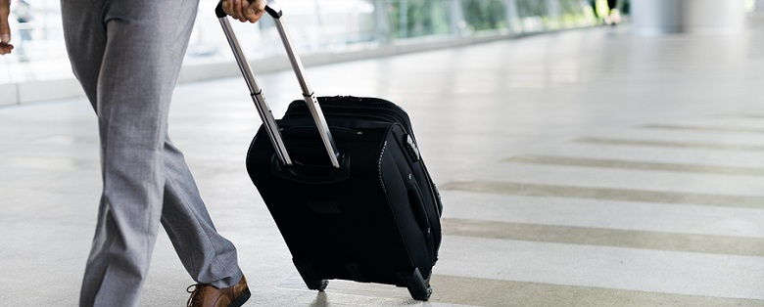
Odejít, opustit, nechat
Leave
Left
Left
I left an airport.
I didn´t leave an airport.
Did you leave an airport?

Slide 3

Zlomit, rozbít
Break
Broke
broken
You broke my heart.
You didn´t break my heart.
Did you break my heart?

Slide 4
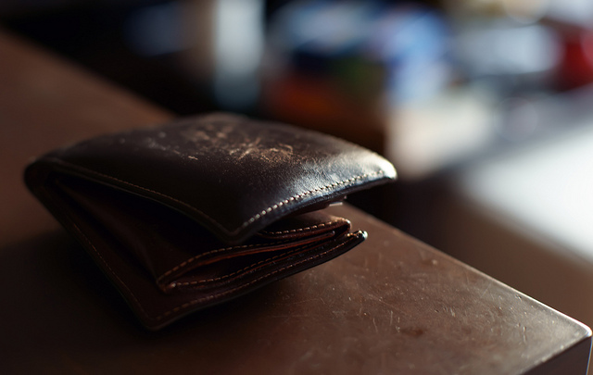
zapomenout
Forgot
Forget
Forgotten
You forgot your wallet.
You didn´t forget your wallet.
Did you forget your wallet?

Slide 5
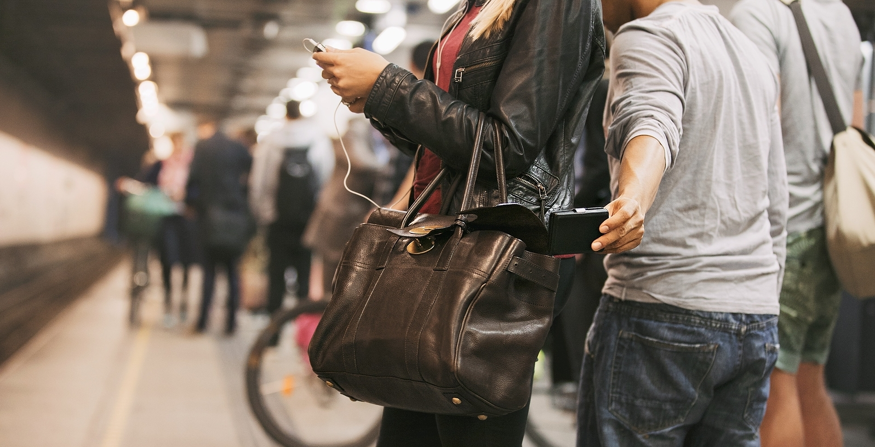
ukrást
Steal
Stole
stolen
Someone stole your wallet.
Someone didn´t steal your wallet.
Did someone steal your wallet?

Slide 6
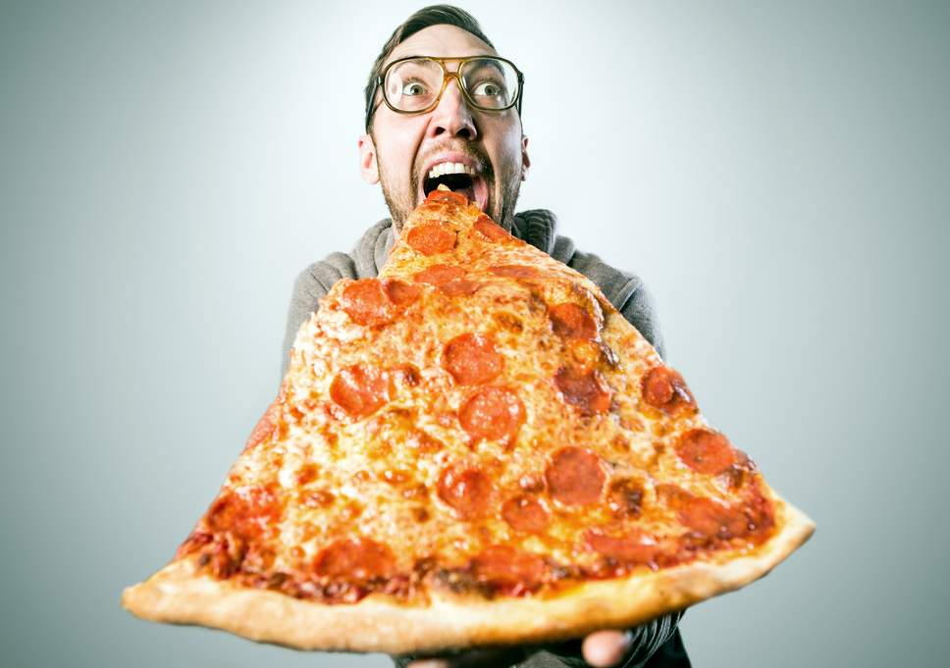
jíst
Eat
Ate
Eaten
He ate pizza yesterday.
He didn´t eat pizza yesterday.
Did he eat pizza yesterday?

Slide 7

Jít, chodit
Go
Went
Gone
I went home yesterday.
I didn´t go home yesterday.
Did you go home yesterday?

Slide 8

mít
Have
Had
Had
I had good marks.
I didn´t have good marks.
Did you have good marks?

Slide 9

být
Be
Was, were
been
I was a good girl. You were a bad boy.
I wasn´t a good girl. You weren´t a bad boy.
Was I a good girl? Were you a bad boy?

Slide 10
I ______________(leave) the airport.
He_____________(break) his leg.
She _______________(forget) her wallet.
They______________(steal) the bag.
We________________(eat) pizza.
You________________(have) your book.
I_______________(be) at home.

Slide 11
Did you….?
odešel z letiště?
zlomil ruku?
zapomněl knihu?
ukradl tužku?
jedl pizzu?
šel domů?
měl bratra?

Slide 12
Odešel jsem ze školy.
Zlomil jsem si tužku.
Zapomněl jsem domácí úkol.
On ukradl tašku.
Jedli jsme špagety.
Oni šli domů.
Oni měli zelené auto.
My jsme byli ve škole.
Já jsem byl doma.

Slide 13
leave
break
forget
steal
eat
go
have
be

