Slide 1
Talk for one minute about ...

Slide 2
1
2
3
4
5
6
7
8
9
10
11
12
Read the rules.
Choose a number.

Slide 3
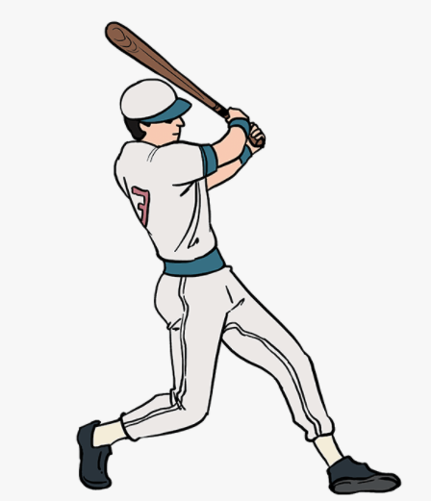
Talk for one minute about
1
BACK
sport
What kind of sport do you like?
What kind of sport you don´t like?
Is sport good for your body?
Are the sportsman healthier?
End

Slide 4
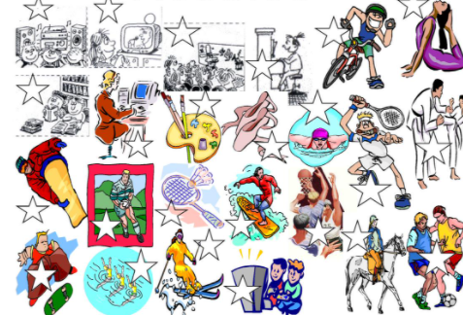
Talk for one minute about
2
BACK
hobbies
What is your hobby?
What other hobbies do you know?
What about your friends – what hobbies do they have?
End

Slide 5
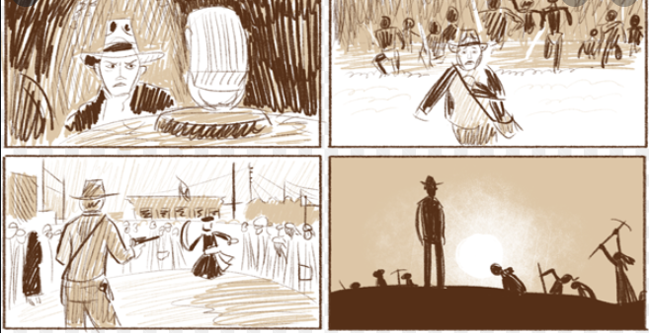
Talk for one minute about
3
BACK
an interesting film
What is the name of the film?
What are the characters of this film?
What is it about?
Is it a romantic /drama / criminal / family film?
End

Slide 6
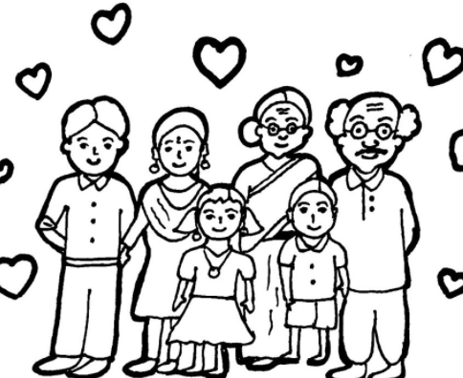
Talk for one minute about
4
BACK
an ideal family
What is an ideal family?
Is it possible to have a perfect family?
Is your family a perfect family?
End

Slide 7
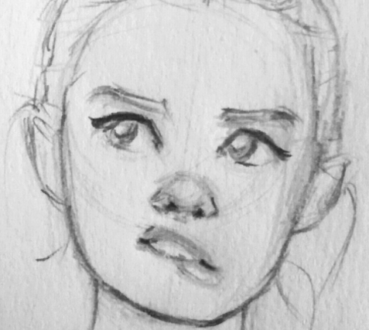
Talk for one minute about
5
BACK
your typical day
When do you usually get up?
What do you do then?
When do you learn?
What do you do after learning?
What do you usually have for lunch/dinner?
When do you go to bed?
End

Slide 8
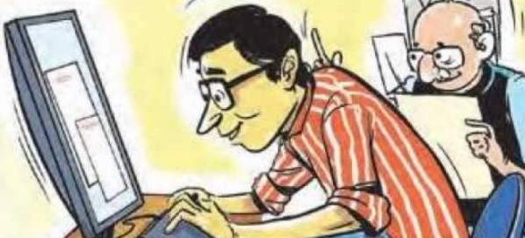
Talk for one minute about
6
BACK
your learning
Do you prefer learning at school or at home?
Is online learning effective?
When do you get up when you have an online learning?
When do you get up when you have school learning?
How much time do you spend by writing homework?
End

Slide 9
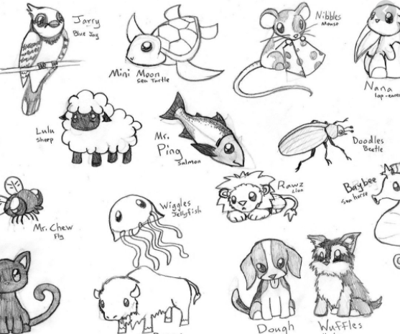
Talk for one minute about
7
BACK
animals
Do you have any pet?
What animal do you like/dislike?
Do you like going to the ZOO?
End

Slide 10
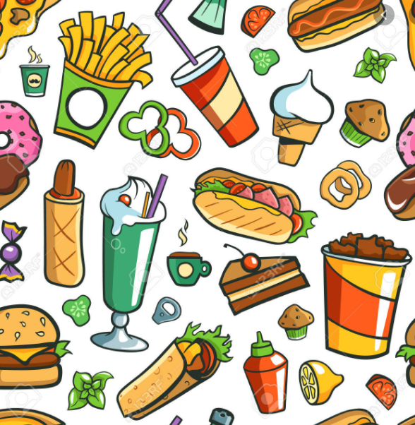
Talk for one minute about
8
BACK
food
What food do you like?
Can you cook?
Do you like eating fruit/vegetable?
Do you like Italian/Mexican/Japanese food?
End

Slide 11
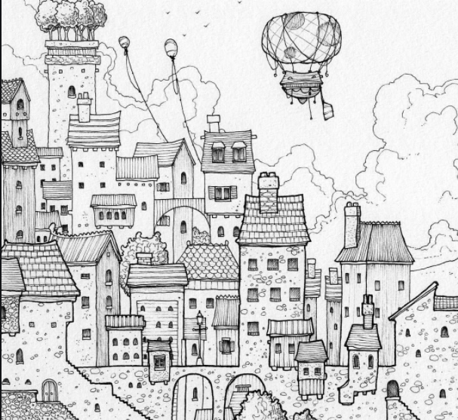
Talk for one minute about
9
BACK
your hometown
Where do you live? How big is your hometown? How many people are there?
What is in your hometown? (shops/swimming pool / square / church / castle…)
Do you like living in your hometown?
How do you get to school?
End

Slide 12
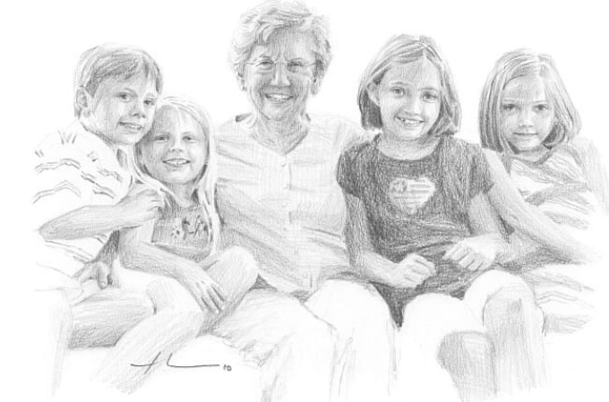
Talk for one minute about
10
BACK
your family
What is your mum´s name / age / job / hobbies?
What is your dad´s name / age / job / hobbies?
What are your sister´s /brother´s name / age / hobbies?
End

Slide 13
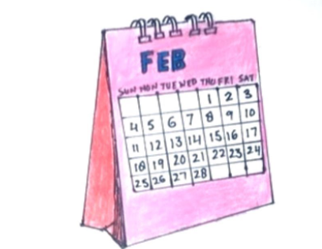
Talk for one minute about
11
BACK
your favourite month of the year
What month is your favourite? Why?
What do you like doing in this month?
What is the weather like?
End

Slide 14
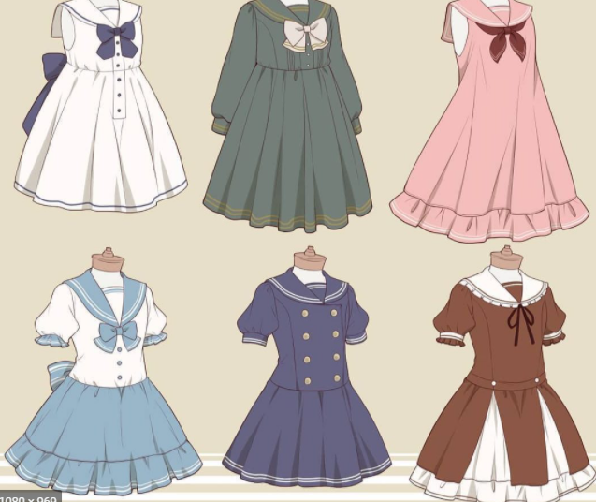
Talk for one minute about
12
BACK
clothes
What are you wearing now?
What do you like wearing?
Do you like shopping clothes?
Do you have any favourite colour?
End

