Slide 1
Let´s play the game
PRESENT CONTINUOUS (přítomný čas průběhový)
Talk about pictures for 15, 30 or 45seconds.
Use present continuous to describe the action.
Also you can use THERE IS A…. THERE ARE…. I CAN SEE… IN THE PICTURE…
Enjoy the game☺

Slide 2
10
20
30
10
20
30
10
20
30
10
20
30

Slide 3
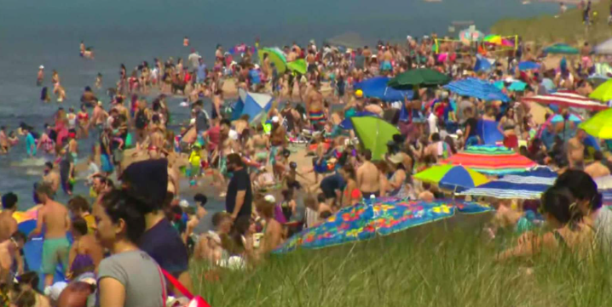
1. Orange 10 points – What is happening? (15sec talking)

Slide 4

2. Orange 10 points – What is happening? (15sec talking)

Slide 5

3. Orange 10 points – What is happening?
(15 sec talking)

Slide 6

4. Orange 10 points – What is happening?
(15 sec talking)

Slide 7
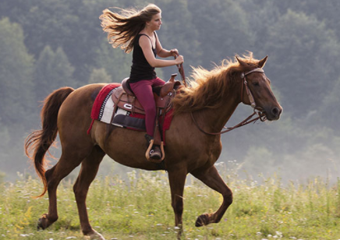
1. Yellow – 20 points – What is happening? (30sec talking)

Slide 8
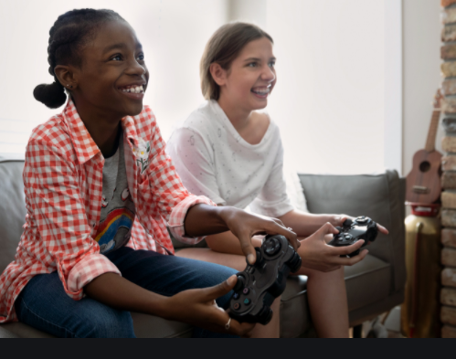
2. Yellow – 20 points – What is happening? (30sec talking)

Slide 9
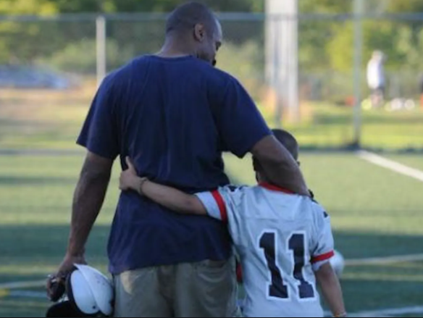
3. Yellow – 20 points – What is happening? (30sec talking)

Slide 10
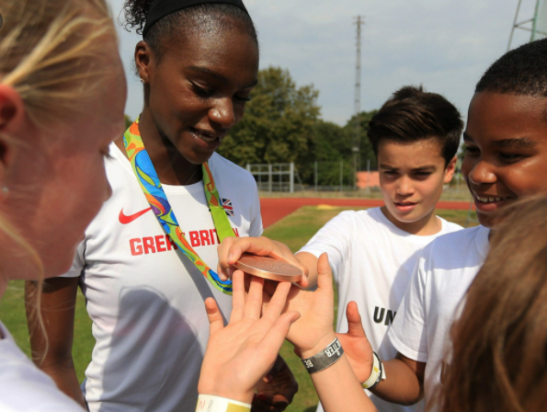
4. Yellow – 20 points – What is happening? (30sec talking)

Slide 11
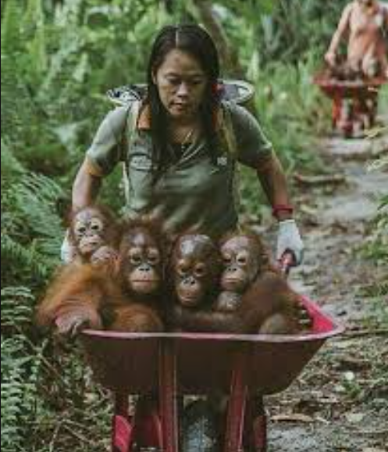
1. Green – 30 points – What is happening? (45sec talking)

Slide 12

2. Green – 30 points – What is happening? (45sec talking)

Slide 13
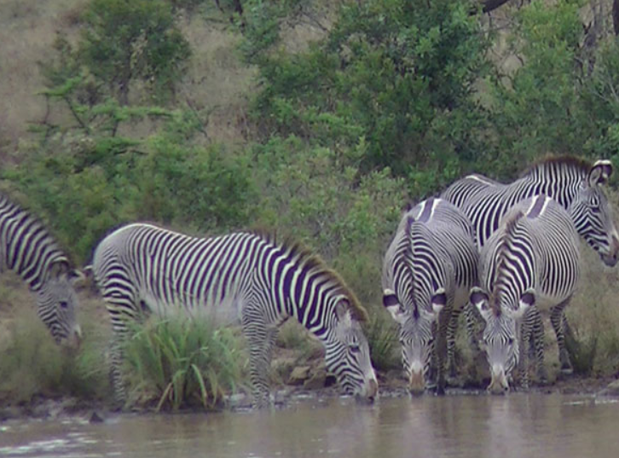
3. Green – 30 points – What is happening? (45sec talking)

Slide 14
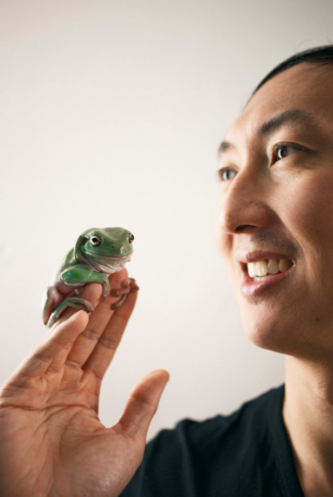
4. Green – 30 points – What is happening? (45sec talking)

