Slide 1
Past Simple
was / were

Slide 2
Tom
is
at school today.
is
was
Tom
was
at home yesterday.
We
are
at school today.
are
were
We
were
at home yesterday.

Slide 3
 | positive | negative | at school yesterday.
I
He
was
wasn’t
She
It
We
were
weren’t
You
They

Slide 4
questions |  | at school yesterday?
I
Was
he
she
it
we
Were
you
they

Slide 5
Short answers
Was
he at home yesterday?
Yes, he
was.
No, he
wasn’t.
Were
you at home yesterday?
Yes, you
were.
No, you
weren’t.

Slide 6
Bob & Bill

Slide 7
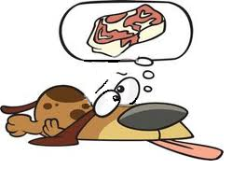
One day, Bill
was
hungry.

Slide 8
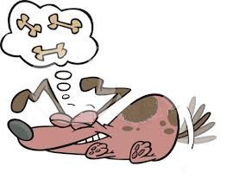
Bob
was
hungry, too.

Slide 9
Fred
was
in the park.
He
wasn’t
hungry.

Slide 10
Chuck,
Ted,
Benji,
and Beethowen
were
also in the park.
They
weren’t
hungry.
They
were
happy.

Slide 11
Ted said:
“There
was
a sign, Bill.”

Slide 12
He also said:
“It
was
very funny.”

Slide 13
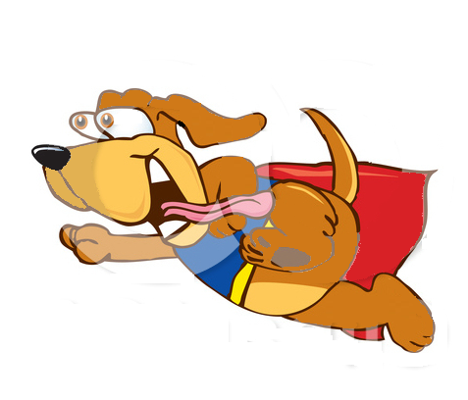
Soon we
were
in the park, too.
We
were
fast and we
were
still hungry.

Slide 14
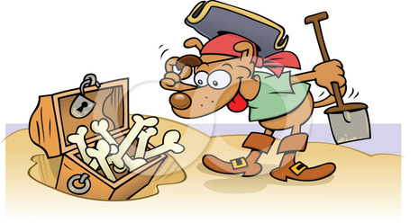
There
was
a chest in the sandbox.
It
was
full of bones.
There
were
bones for everyone.

Slide 15
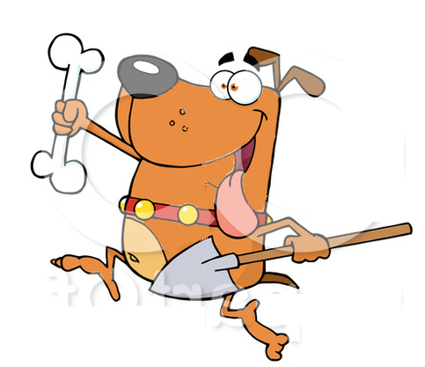
There
was
a bone for Bob…
…and one for Ted…
… and one for Fred.

Slide 16
There
were
bones everywhere.

Slide 17
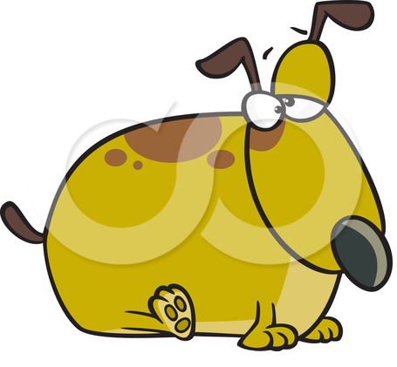
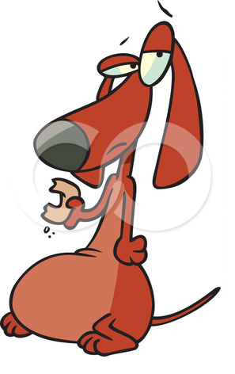
The friends
were
never more
H U N G R Y!

Slide 18
Now YOU try!

Slide 19
I __________ at home yesterday.
were
wasn’t
weren’t
I __________ at school.
was
wasn’t
were
I __________ happy, because
was
wasn’t
were
my friends __________ at school, too.
was
were
weren’t
They __________ happy, too.
wasn’t
were
weren’t

Slide 20
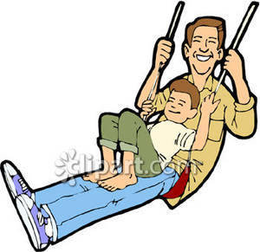
Tom __________ in the playground last week.
was
wasn’t
were
He __________ with his dad.
was
wasn’t
were
Tom’s mum __________ in the playground.
was
wasn’t
were
Tom __________ on the slide.
wasn’t
was
weren’t
He __________ on the swing.
wasn’t
was
weren’t

Slide 21
Sally and Tom __________ in the ZOO last weekend.
was
wasn’t
were
There __________ elephants in the ZOO.
was
were
weren’t
They __________ huge.
was
were
weren’t
But the children _________ scared.
was
were
weren’t
It __________ great!
was
wasn’t
were

Slide 22
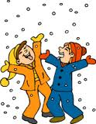
Yesterday it __________ snowy.
was
wasn’t
were
It __________ hot, but
was
wasn’t
were
the boys __________ sad.
were
weren’t
wasn’t
They __________ happy.
were
was
weren’t
The children __________ in the garden.
was
weren’t
were

Slide 23
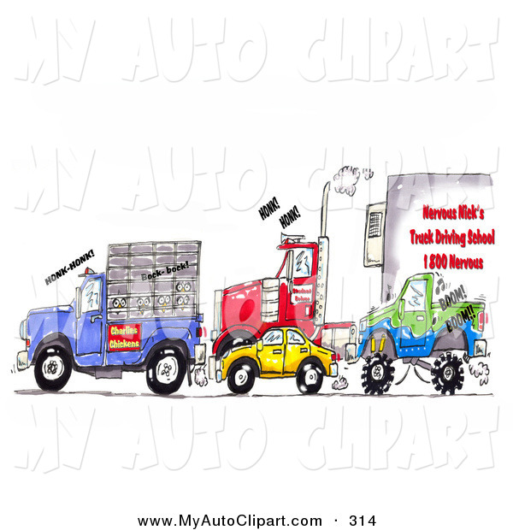
We __________ in the street last Monday.
was
were
weren’t
It __________ quiet.
were
weren’t
wasn’t
It __________ very noisy.
was
wasn’t
were
There __________ many cars.
was
were
weren’t
There __________ some lorries,too.
wasn’t
were
weren’t

Slide 24
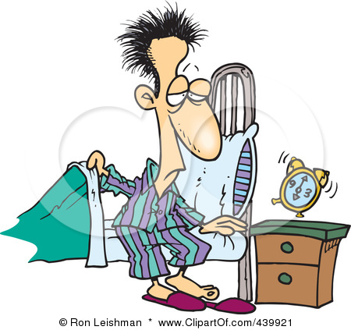
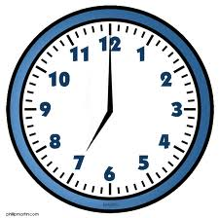
It __________ seven o’clock.
was
wasn’t
were
Tony __________ in bed.
were
wasn’t
was
He __________ happy.
was
wasn’t
weren’t
He __________ asleep,
weren’t
was
wasn’t
but he __________ very sleepy.
was
wasn’t
were

Slide 25
I __________ in the park yesterday.
was
wasn’t
were
Really? __________ it good?
Was
Wasn’t
Were
Yes, it __________ great!
was
wasn’t
were
__________ there your friends?
Was
Were
Weren’t
No, they _______. I ______ with my dog.
wasn’t
were
weren’t
was
wasn’t
were

