Slide 1
What are you doing?
I + am + ing
He / she / it + is + ing
You /we / they + are + ing

Slide 2
Děje se tady a teď
Popis obrázku (zachyceno právě teď)
Zrovna teď něco dělám.

Slide 3
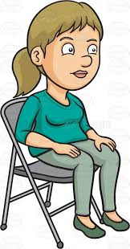
What are you doing?
I am sitting
Sit

Slide 4
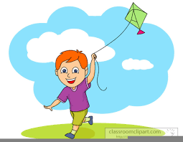
What are you doing?
I am flying a kite.
Fly

Slide 5
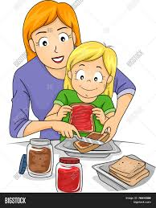
What are you doing?
We are making a sandwich.
Make

Slide 6
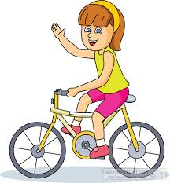
What are you doing?
I am riding a bike.
Ride

Slide 7
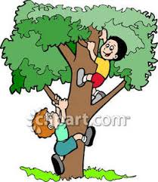
What are you doing?
We are climbing.
Climb

Slide 8
What are you doing?
I am listening to music.
Listen

Slide 9
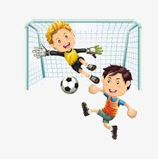
What are you doing?
We are playing soccer.
Play

Slide 10
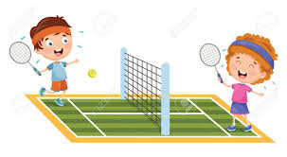
What are you doing?
We are playing tennis.
Play

Slide 11
What are you doing?
We are reading.
Read

Slide 15
What is he doing?
He is swimming.
What is she doing?
She is dancing.
What is it doing?
It is drinking milk.

Slide 16
What are you doing?
I am swimming.
What are you doing?
We are dancing.
What are they doing?
They are drinking milk.

Slide 17
What is she doing?
She is sitting.
Sit

Slide 18
What is he doing?
He is flying a kite.
Fly

Slide 19
What are they doing?
They are making a sandwich.
Make

Slide 20
What is she doing?
She is riding a bike.
Ride

Slide 21
What are they doing?
They are climbing.
Climb

Slide 22
What is he doing?
He is listening to music.
Listen

Slide 23
What are they doing?
They are playing soccer.
Play

Slide 24
What are they doing?
They are playing tennis.
Play

Slide 25
What are they doing?
They are reading.
Read

