Slide 1
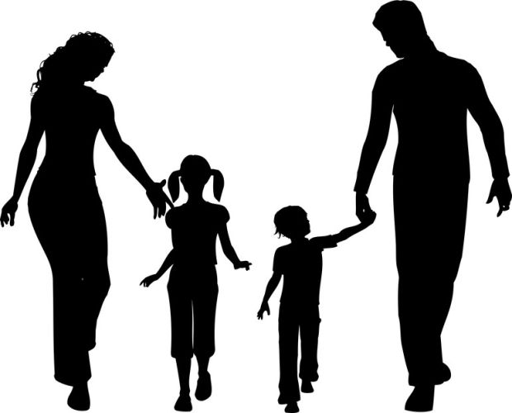
Let’s talk about
PICTURES

Slide 2
Choose a number!
1
3
5
7
2
4
6
8
10
12
14
9
11
13

Slide 3
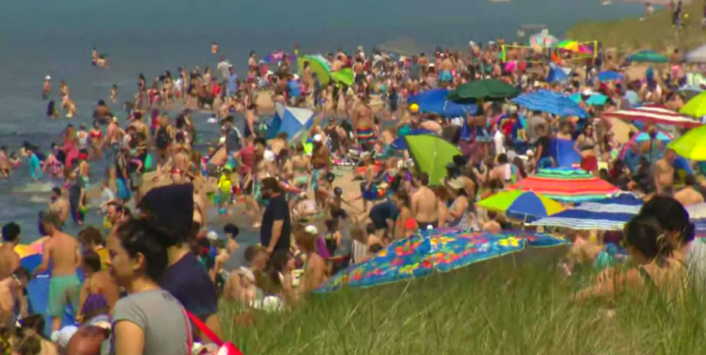
What are these people doing? Where? Why?
Swim
Sun bath
Sit on the grass
Use umbrellas
Enjoy the weather
Thank you.

Slide 4
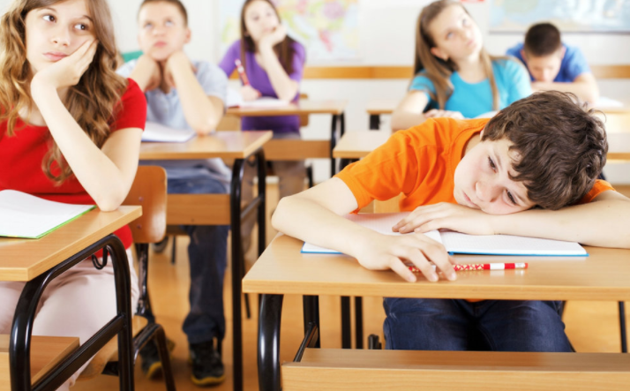
What are the kids doing?
Learn
Tired and bored
Sit behind their desks
Have their books opened
Not enjoy
Thank you.

Slide 5
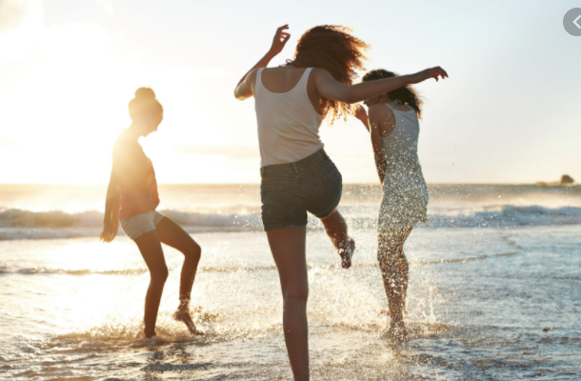
What are they doing?
Enjoy
Play with water
Kick their legs in the water
Have holidays
Thank you.

Slide 6
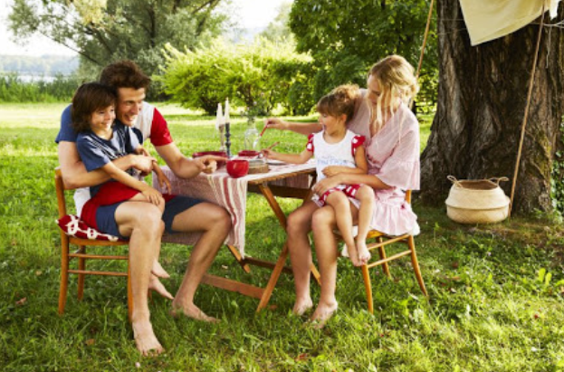
What are they doing?
Have tea outside
Sit under the tree
Smile
Show something
Drink tea
Thank you.

Slide 7
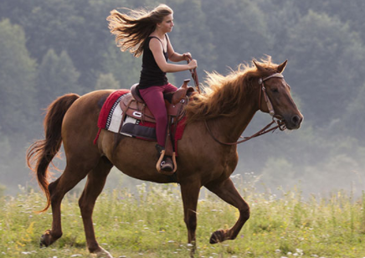
What is she doing?
Ride a horse
A horse/run
Enjoy
Thank you.

Slide 8
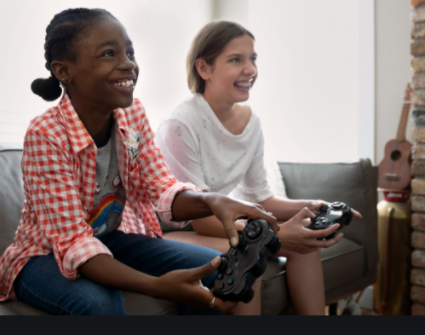
What are they doing?
Play games
Smile
Enjoy the time together
sit
Thank you.

Slide 9
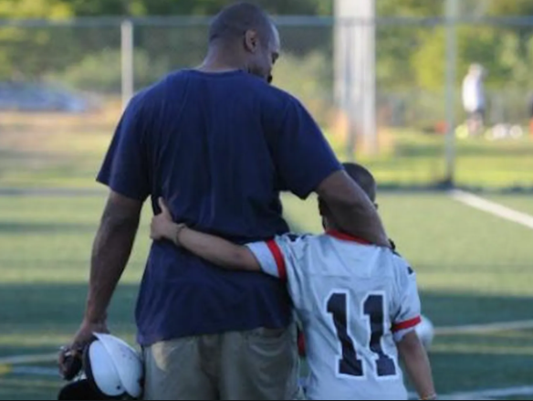
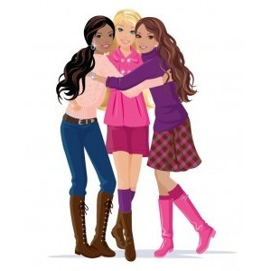
What are they doing?
Hold ech other
Stand in front of the football pitch
Dad/look at his son
Enjoy being together
Thank you.

Slide 10
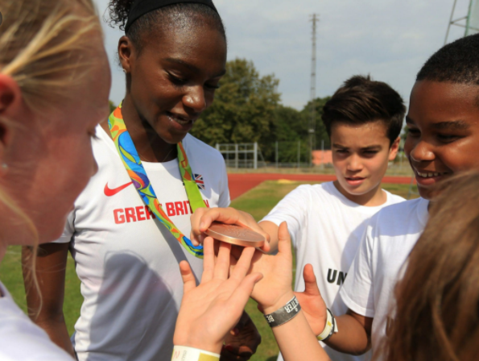
What are they doing?
Show the medail
Stand in the circle
Look at the medail
Admire the prize
Thank you.

Slide 11
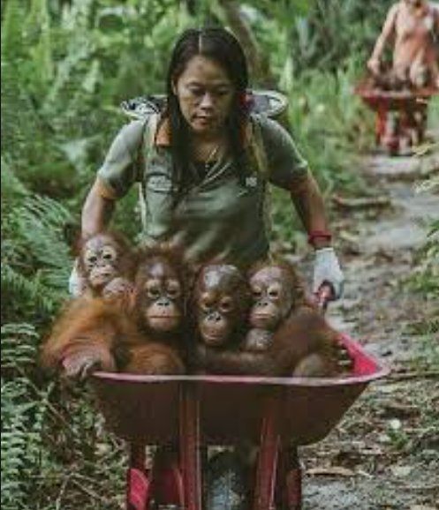
What is happening?
women/carry a wheelbarrow
work in the bush
monkeys/sit in a wheelbarrow
rescue monkeys
Thank you.

Slide 12
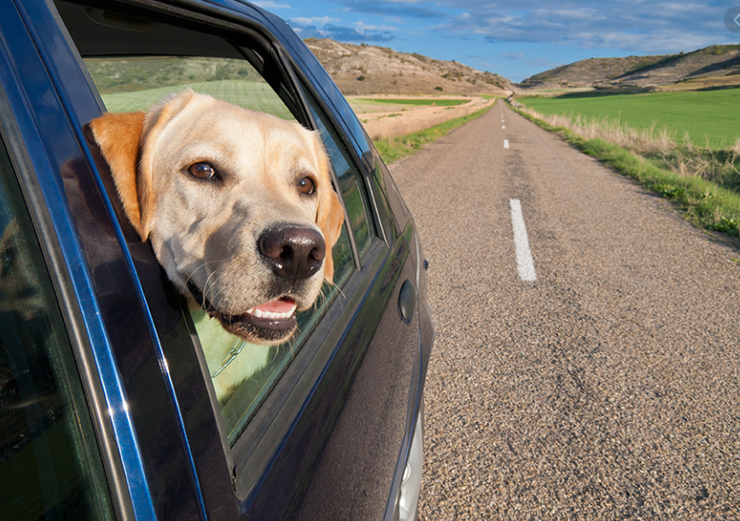
What is happening?
car/go in the road
dog/watch outside the car
Thank you.

Slide 13
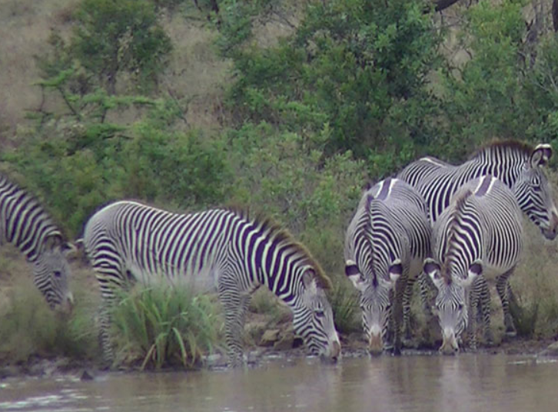
What are they doing? What can you see?
stand in the water
drink
come to the river
Thank you.

Slide 14
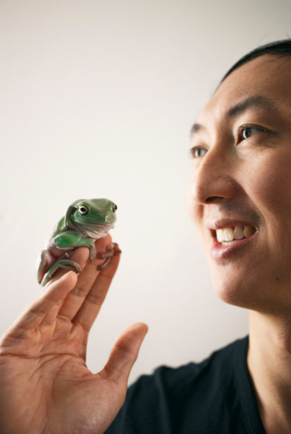
What is happening?
hold a frog
look at someone else
frog/sit on man´s hand
Thank you.

Slide 15
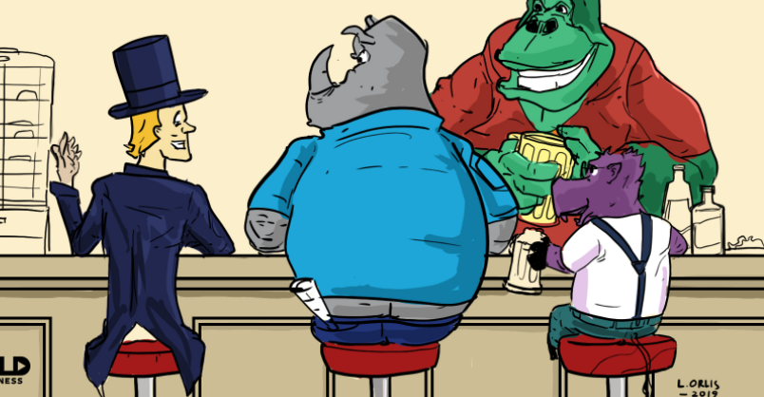
What is happening?
talk to each other
smile
drink beer
have fun
Thank you.

Slide 16
What is happning in the picture?
hold a mobile phone
talk to someone
enjoying the talk
Thank you.

Slide 17
Keep practising!

Slide 18
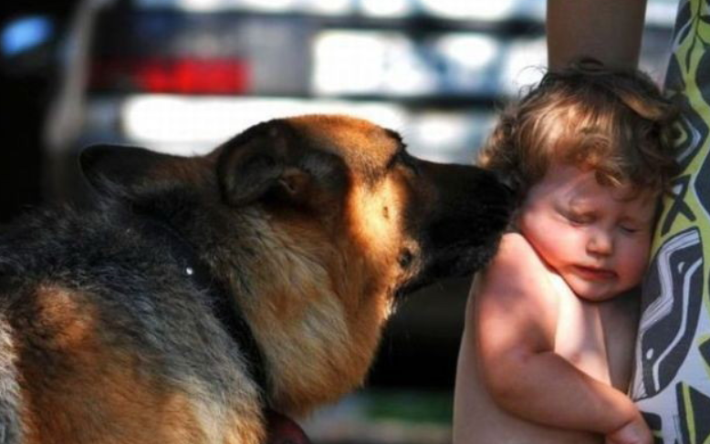
Now you know how to say what is happening☺

