Slide 1
Talk for a minute.
End
Notes:
see next notes section

Slide 2
A
B
C
D
E
F
G
H
I
J
K
L
M
N
O
P
Q
R
S
T
Notes:
students take turns selecting a lettered cloud. Click it, it will hyperlink to a ‘talk for a minute’ slide. Read the question, check understanding, then click to start the minute timer. Student talks. There is an editable text box at the bottom for the teacher to type into while in slideshow mode (just click and type.) Teacher can type out the students answer as they talk, or use it afterwards to explain / correct / elaborate / improve etc. Click the yellow ‘H’ (home) cloud in the top left corner to hyperlink back to the home slide.

Slide 3
Talk for a minute about...
A
your favorite sports.
End

Slide 4
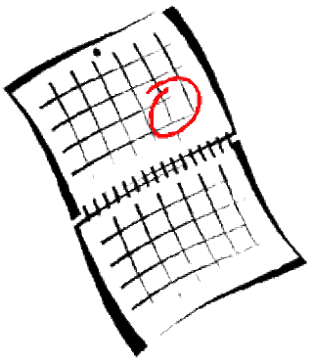
Talk for a minute about...
B
what you did last weekend.
End

Slide 5
Talk for a minute about...
C
your plans for this weekend.
End

Slide 6
Talk for a minute about...
D
your favorite movie.
End

Slide 7
Talk for a minute about...
E
your job.
End

Slide 8
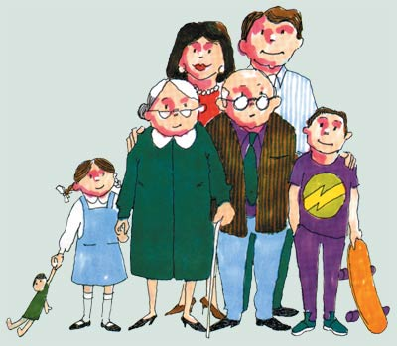
Talk for a minute about...
F
your family.
End

Slide 9
Talk for a minute about...
G
music that you like or don’t like.
End

Slide 10
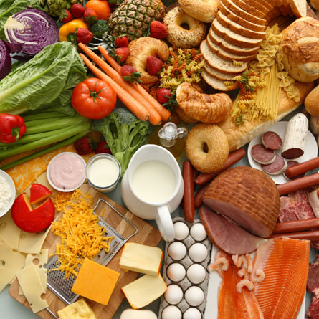
Talk for a minute about...
H
your favorite food.
End

Slide 11
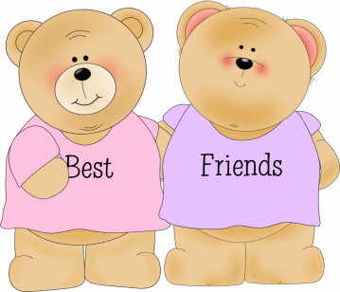
Talk for a minute about...
I
your best friend.
End

Slide 12
Talk for a minute about...
J
your favorite day of the week.
End

Slide 13
Talk for a minute about...
K
your last vacation.
End

Slide 14
Talk for a minute about...
L
something that you don’t like doing.
End

Slide 15
Talk for a minute about...
M
what you want to do next summer.
End

Slide 16
Talk for a minute about...
N
yesterday.
End

Slide 17
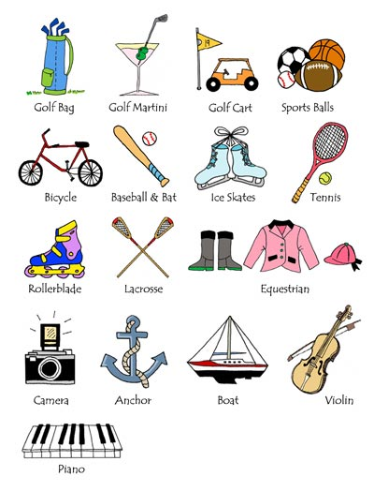
Talk for a minute about...
O
your hobbies.
End

Slide 18
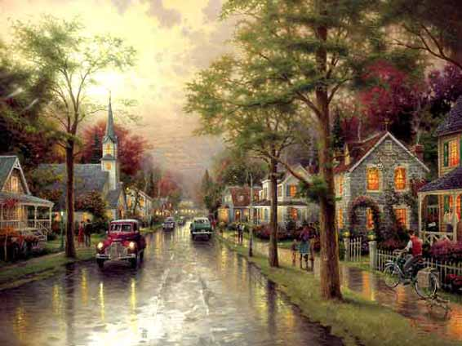
Talk for a minute about...
P
your hometown.
End

Slide 19
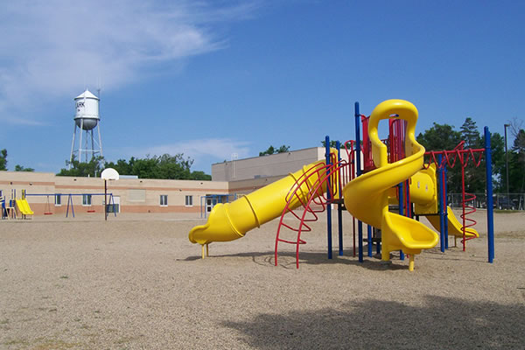
Talk for a minute about...
Q
the elementary school that you attended as a child.
End

Slide 20
Talk for a minute about...
R
your home.
End

Slide 21
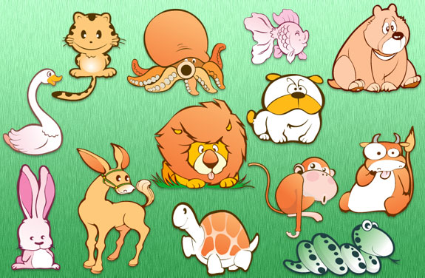
Talk for a minute about...
S
your favorite or least favorite animals.
End

Slide 22
Talk for a minute about...
T
your daily schedule.
End

