Slide 1
FOOD & COOKING

Slide 2
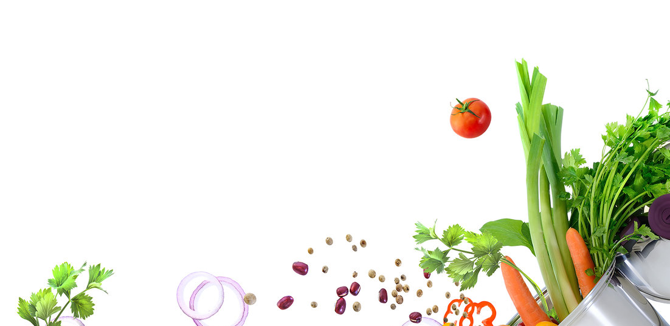
What is your favourite food?

Slide 3
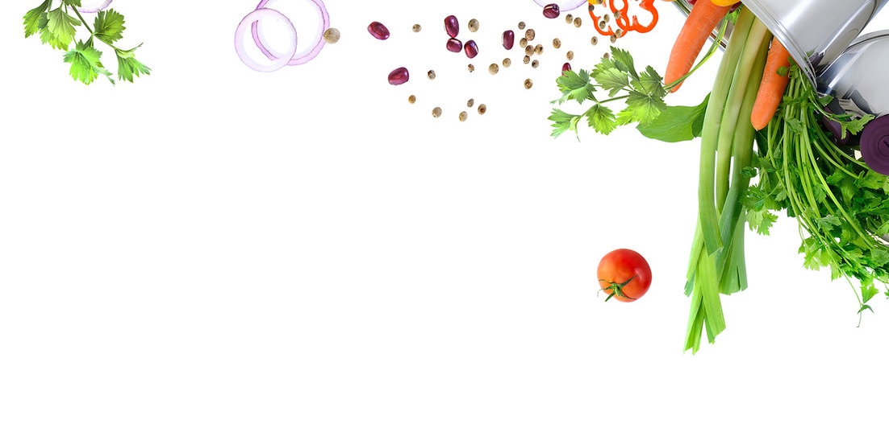
COMMON INGREDIENTS
What food do you usually cook with?

Slide 4
INGREDIENTS
garlic
onion

Slide 5
INGREDIENTS
oil
tomato

Slide 6
INGREDIENTS
fish
chicken

Slide 7
INGREDIENTS
pork
black pepper

Slide 8
INGREDIENTS
potato
carrot

Slide 9
INGREDIENTS
egg
rice

Slide 10
INGREDIENTS
cabbage
lemon

Slide 11
food from around the world
What dishes are famous around the world?

Slide 12
tacos
Mexico

Slide 13
fish and chips
United Kingdom

Slide 14
paella
Spain

Slide 15
sushi
Japan

Slide 16
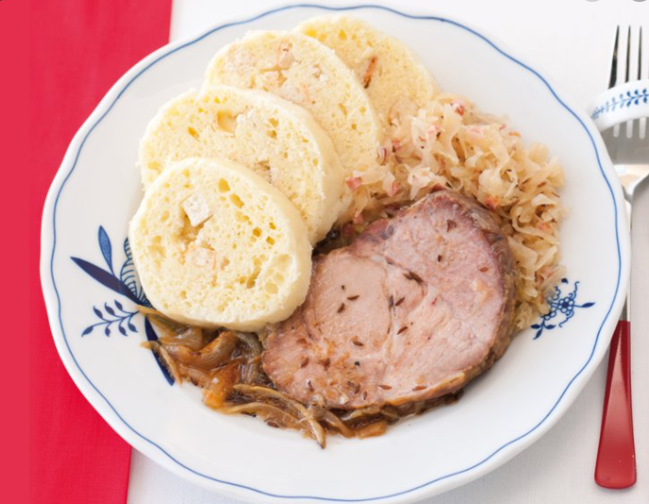
Dumplings, pork and cabbage
The Czech Republic

Slide 17
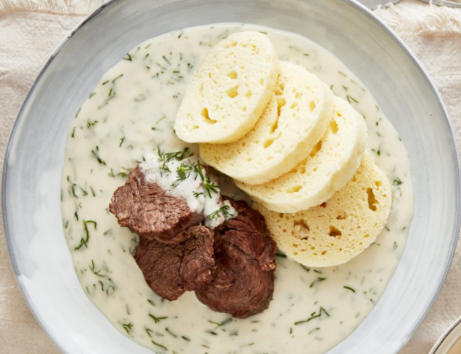
Dill sauce with dumplings
The Czech Republic

Slide 18
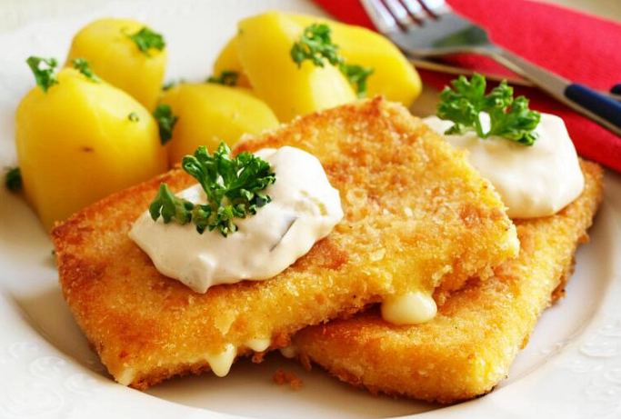
Fried cheese
The Czech Republic

Slide 19
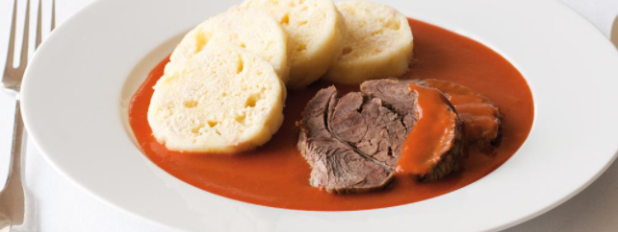
Tomato sauce with dumplings
Czech Republic

Slide 20
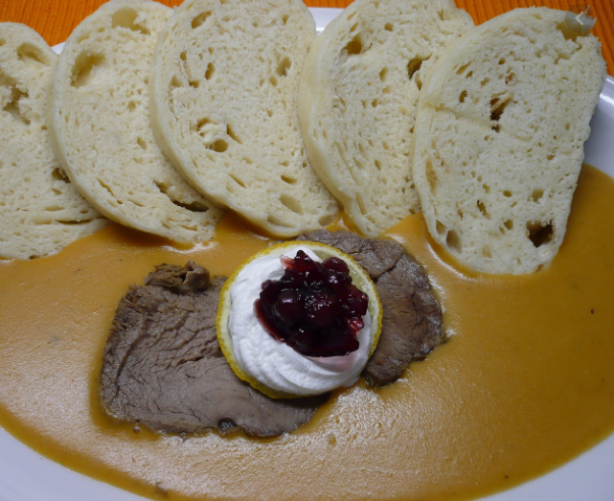
sirloin
The Czech Republic

Slide 21
spaghetti
Italy

Slide 22
COOKING METHODS
How do you cook your food?

Slide 23
boiling
The food is in a very hot water or liquid. The temperature is very high which creates bubbles.

Slide 24
steaming
The food is on top of a boiling water or liquid. The moist hot air cooks the food.

Slide 25
frying
Food is cooked in very hot oil.

Slide 26
baking
Food is cooked inside an oven.

Slide 27
grilling
Food is cooked quickly on top of an open flame.

Slide 28
roasting
Food is cooked slowly in hot temperature usually in an open flame.

Slide 29
IN THE KITCHEN
What things do you have in your kitchen?

Slide 30
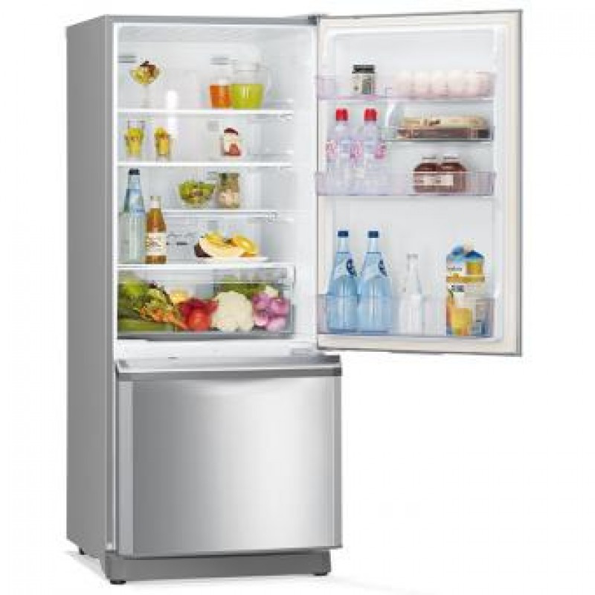
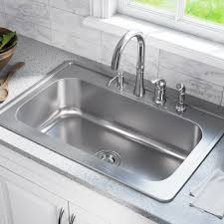
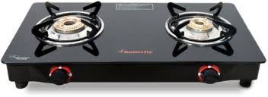
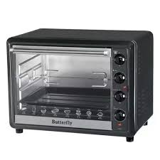
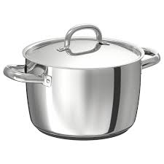
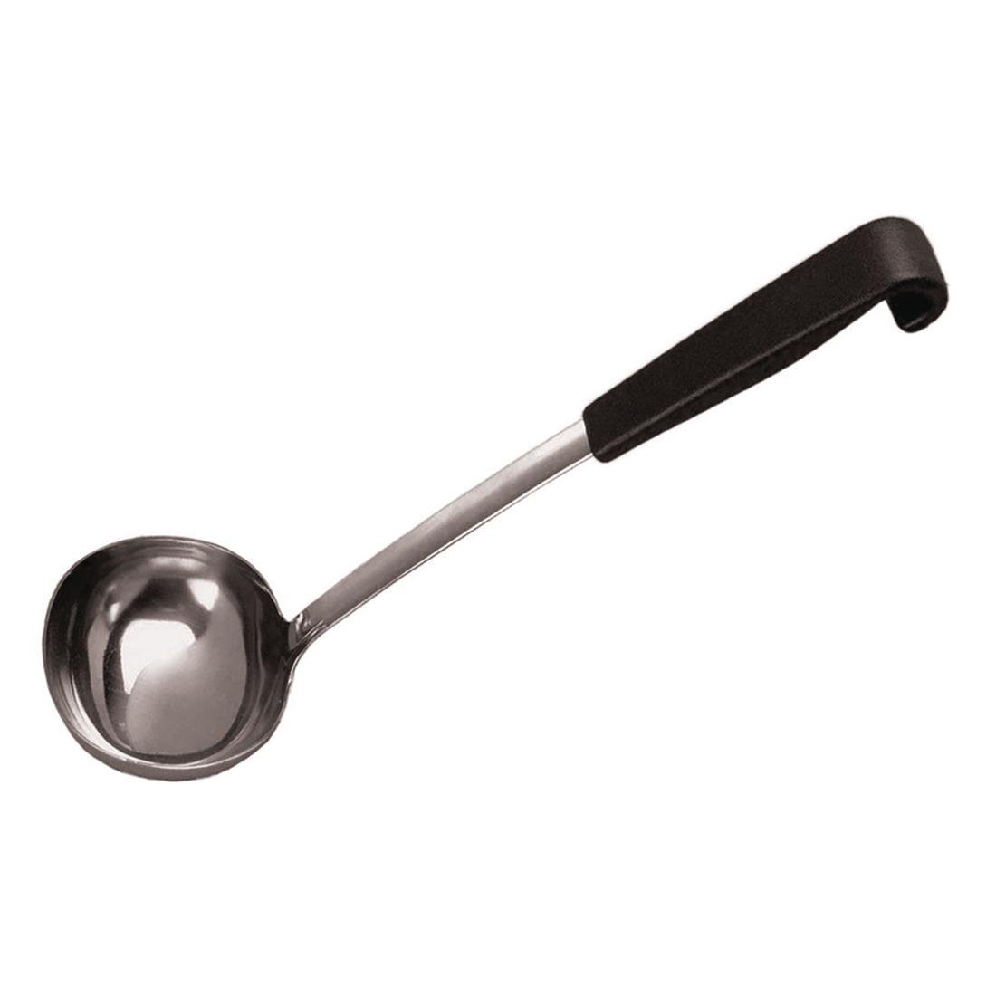
fridge
stove
sink
pot
oven
ladle

Slide 31
sweet | salty | spicy bitter |sour
spicy
Food from India and Sichuan can be very __________ .
Eating foods that are too __________ can cause diabetes.
__________ is the taste of lemon.
Most potato chips are very __________ .
Some people don’t like beer because it is __________ .
sweet
Sour
salty
bitter

Slide 32
always | usually | sometimes rarely | never
How often do you cook food?
How often do you eat in restaurants?
How often do you eat in fast foods?
How often do you eat meat?
How often do you eat fruit and vegetables?

Slide 33
CONVERSATION
Do you know how to cook?
How often do you cook?
Do you want to learn how to cook well?
Do you watch cooking shows? Why or why not?
What are your favorite fruits and vegetables?
Describe your favorite food.
What vegetable do you dislike?
What fruit do you dislike?
What famous food from your country do you often eat?
What famous food from another country do you like?

Slide 34
THANK YOU!
Alena Mikulecká

